Slide 1
NIH Systems Interoperation Working Group
Intro & Update
2020-03-17
Brian O'Connor
Broad Institute

Slide 2
NIH Systems Interoperation Working Group
NIH Systems Interoperation Working Group was created as an outcome of the NIH Workshop on Cloud-Based Platforms Interoperability held at RENCI Oct 3-4th, 2019
The group's Charter establishes the group's mission, members/teams, high-level scientific and technical goals, and a timeline for our work in 6 month increments.
Goal: the group will spearhead technical improvements to cloud "stacks" created by the Common Fund (Kids First Data Resource Center), NCI (CRDC), NHGRI (AnVIL), and NHLBI (BioData Catalyst) that enable improved interoperability. We will demonstrate progress based on realistic researcher use cases every 6 months.

Slide 3
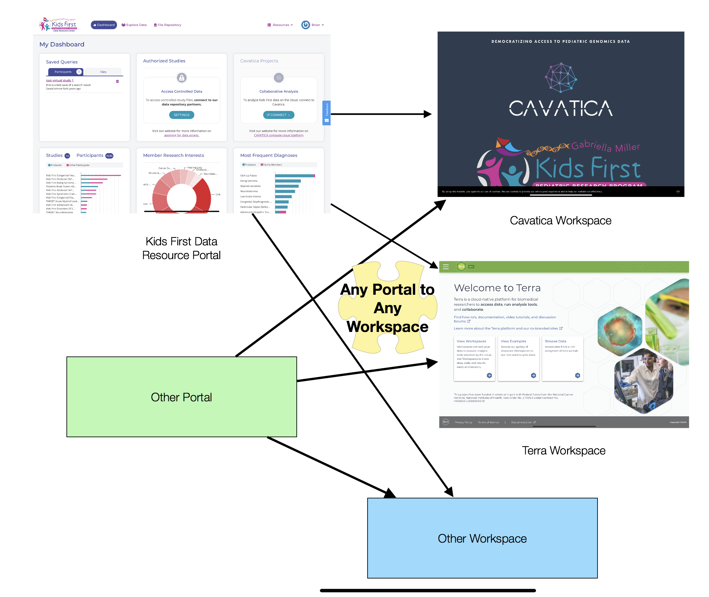
NIH Systems Interoperation Working Group
The NIH Systems Interoperation Working Group goals for the first 6 months:
Looking at interop between 4 distinct Data Portals and 3 Work Space environments (Terra, SBG, and Gen3)
Not looking at all APIs/points of interoperation initially. Instead, looking for achievable improvements to interoperation between these multiple groups.
See the Technical Plan

Slide 4
NIH Systems Interoperation Working Group
First effort due by April is to provide a lightweight mechanism by which Data Portals can "hand off" search results to compute environments.
Allows researchers to "shop" for data on Kids First, AnVIL, BDCat, and CRDC and compute in Terra, SBG, and Gen3.
PFB and DRS are used to send metadata + data references to compute environments

Slide 5
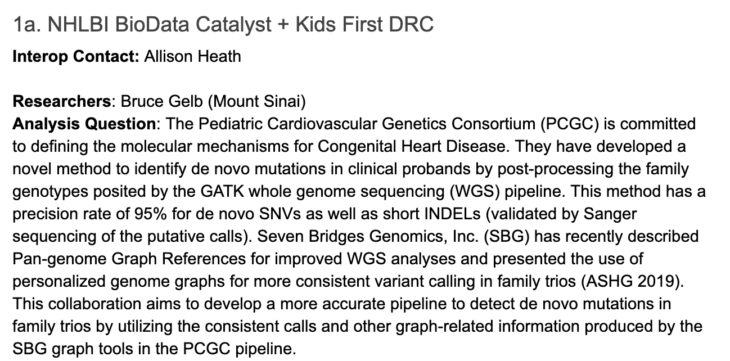
NIH Systems Interoperation Working Group
All work is grounded in Researcher Use Cases
So far we have 6 high-quality use cases that span multiple groups and datasets
See the group Charter for our use cases

Slide 6
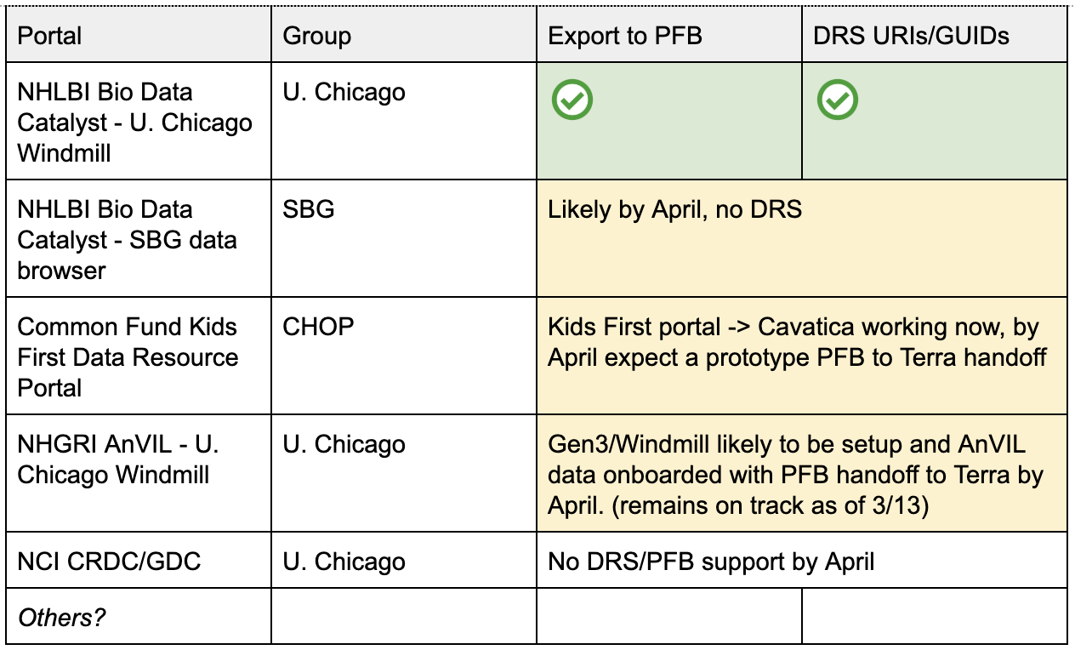
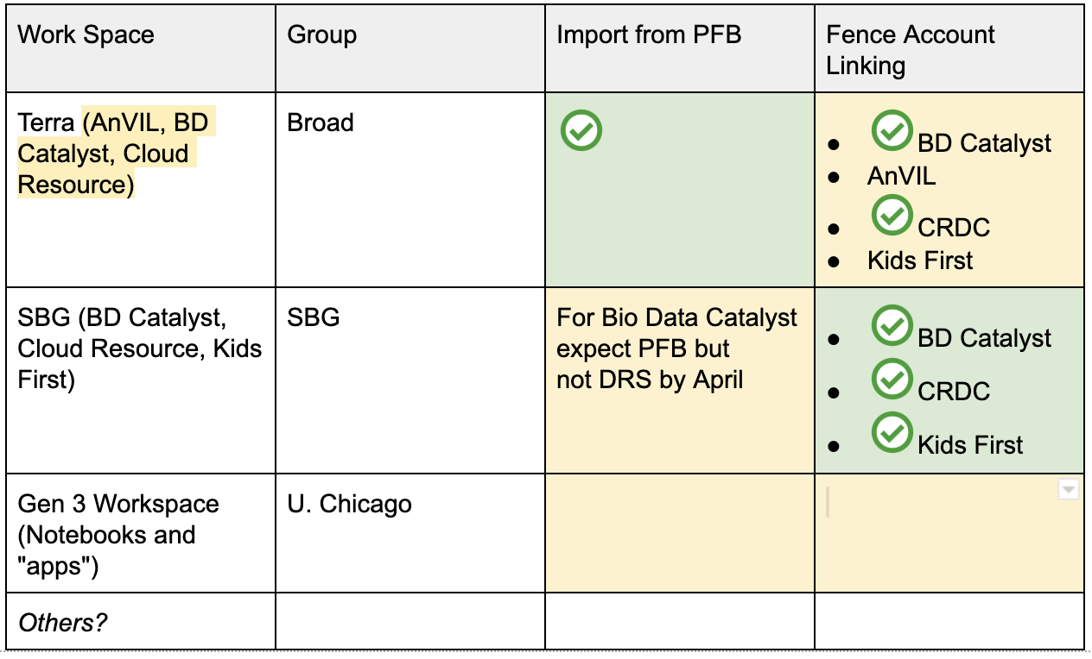
Current Status - Technical
Data Portals
Workspaces
We are tracking progress in the technical plan document

Slide 7
Current Status - Researcher Use Cases
On the last call we discussed the status of each researcher use case:
3 out of the 6 use cases showed good progress for April (1b. NHLBI BioData Catalyst + Kids First DRC, 5. NCI CRDC + NHGRI AnVIL, and 2. NHLBI BioData Catalyst + Kids First DRC), we anticipate others will show progress as well
Challenges:
DRS 1.1 with GUID support a work in progress, PFB also a work in progress
Working around systems that don't currently support these common APIs
Balance between doing the analysis once vs. any user being successful on their own
Trying to understand how RAS/auth fits in, should enable nicer user experience in the future
We are tracking progress on Use Cases in the notes document

Slide 8
For More Information...
See the NIH Systems Interoperation Working Group docs. Consider joining the effort!
Charter
Technical Plan
2nd and 4th Fridays at 12pm Pacific time
See the Agenda & Notes document for details on how to join
The April (online) Interop meeting will afford an opportunity to assess where we stand 1) technically and 2) on researcher use cases. It will also give us an opportunity to plan the next 6 months.

