Slide 1
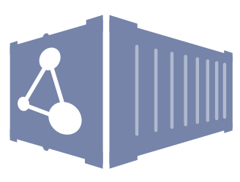
Intro to Dockstore
Louise Cabansay
UC Santa Cruz, Genomics Institute
Software Engineer, Dockstore
Notes:
presentation will be a combination of a end-user overview and some interoperability highlights for developers
For time, I’ve cut out the live demos here, but Beth will largely be covering the same content during her presentation tomorrow

Slide 2
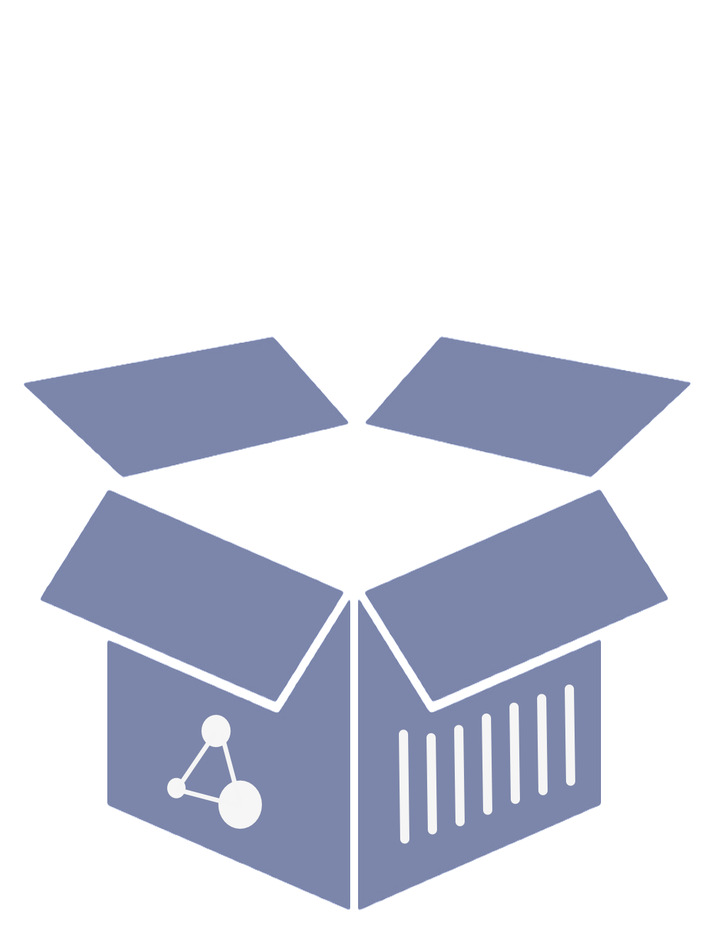
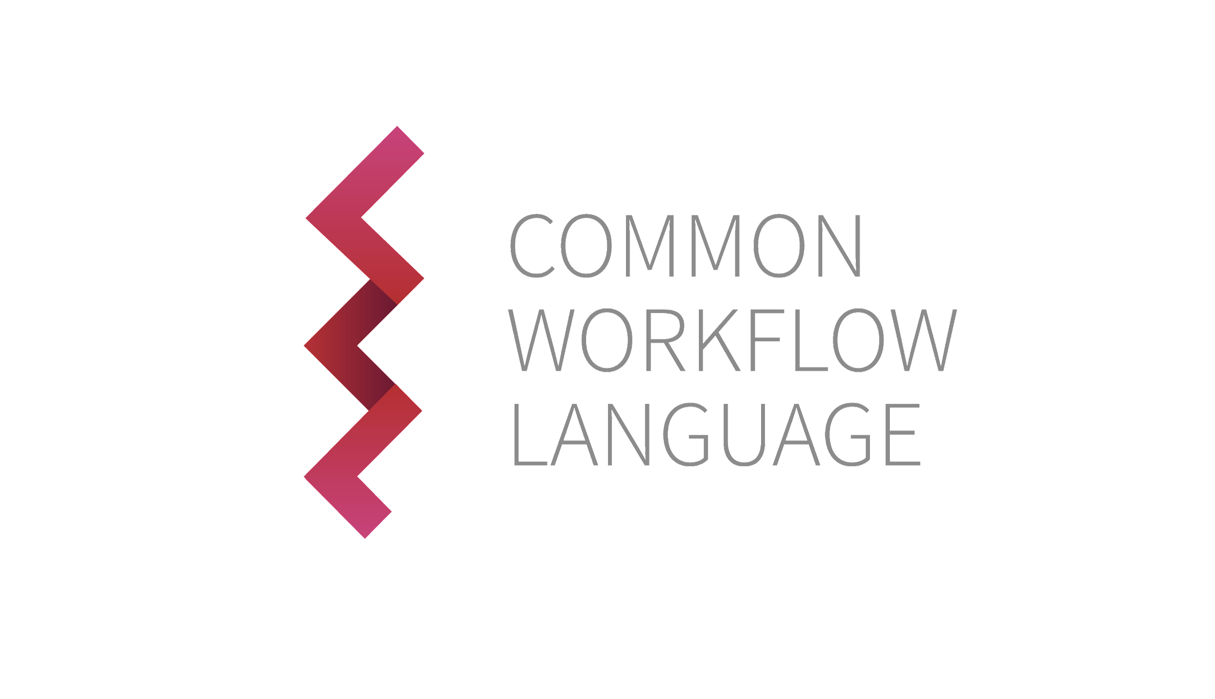
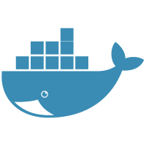
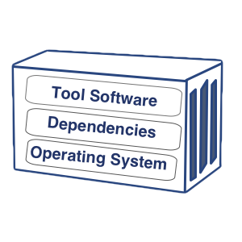
What is Dockstore?
Dockstore is a free and open source platform for sharing scientific tools and workflows. It is a registry of Docker-based resources described using popular workflow languages CWL, WDL, and Nextflow.
Portability
Run workflows in any environment that supports Docker
Interoperability
Standardize computational analysis through GA4GH APIs
Reproducibility
Create, Share, Use
Containers + Popular descriptor languages
Notes:
What is Dockstore? Let me first give you the full description.
Our goals are to increase the portability, interoperability, and reproducibility of research in the sciences.
Portability means workflows should run in any environment that supports Docker,
And for interoperability we follow the GA4GH API standards and support multiple integrations
Use preferred compute and data storage environments
Most importantly, Reproducibility
Dockstore is a place for researchers and developers to share their work so that others can use it.
The combination of using containers and workflow languages minimizes redundant and error prone installation
increases the transparency of methods used in analysis
allows others to verify results and apply existing methods into their own research.

Slide 3
What is Dockstore? (simple, tl;dr)
A platform for sharing research software
An ‘app store’ for bioinformatics
Notes:
But in simple terms, what is Dockstore?
You can think of it as an ‘app store’ for bioinformatics

Slide 4
How is Dockstore useful?
What problems does it solve?

Slide 5
Simplest Use Case: Search and Findability
A researcher wants to do some type of genomics work (assembly, alignment, variant calling, GWAS, etc.)
What software can be used for the job?
What works with their data?
Where do they download the software? What version?
Notes:
As our first example, let’s go over the simplest use case: search and findability

Slide 6
Dockstore as a Registry
Searchable and Centralized catalogue of bioinformatics tools and workflows
Many ways to get tools and workflows into Dockstore!
External Hosting: Github, Bitbucket, Gitlab, Quay.io, Docker Hub
Direct Hosting (descriptors)
Notes:
This brings us to Dockstore’s function as a registry
Searchable and Centralized Catalogue
The content on Dockstore can come from multiple locations
Github, Bitbucket, Quay, Dockerhub, or hosted directly on Dockstore
All these resources come together to form a centralized library for a better user experience and functionality
Zenodo: create digital object identifiers for your content and link it directly on your publications

Slide 7
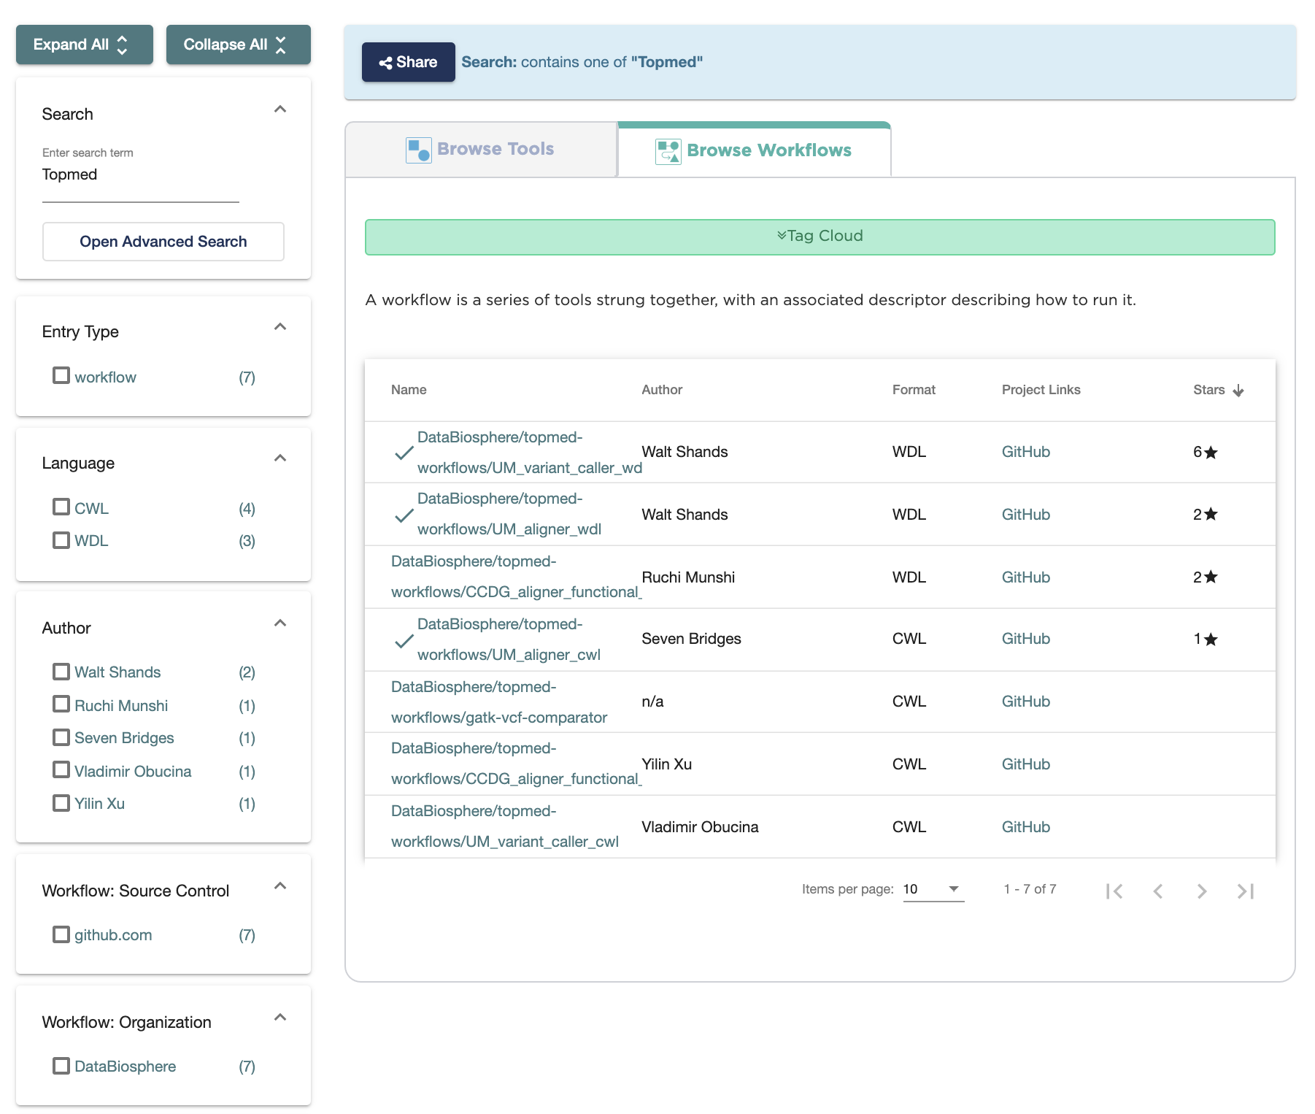
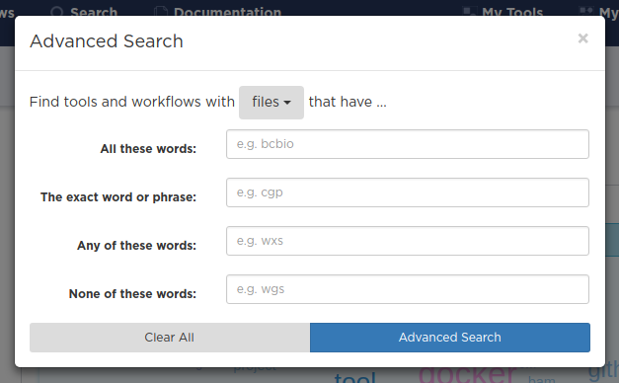
Search Functionality
Search by name, author, organization, descriptor, etc
Filter results using facets
Descriptor Language
Labels
Notes:
Search Interface
Search by name, author, organization, descriptor type, etc
Filter using facets OR use Advanced Search
Navigate to search using toolbar
Example: GATK, TOPmed
Quite a few entries pop up
Filter by
name, verification, author(s), descriptor type, hosting repository, stars (# of user likes)
Lot of results, some content are customized version made by other users -> organizations feature for better curation

Slide 8
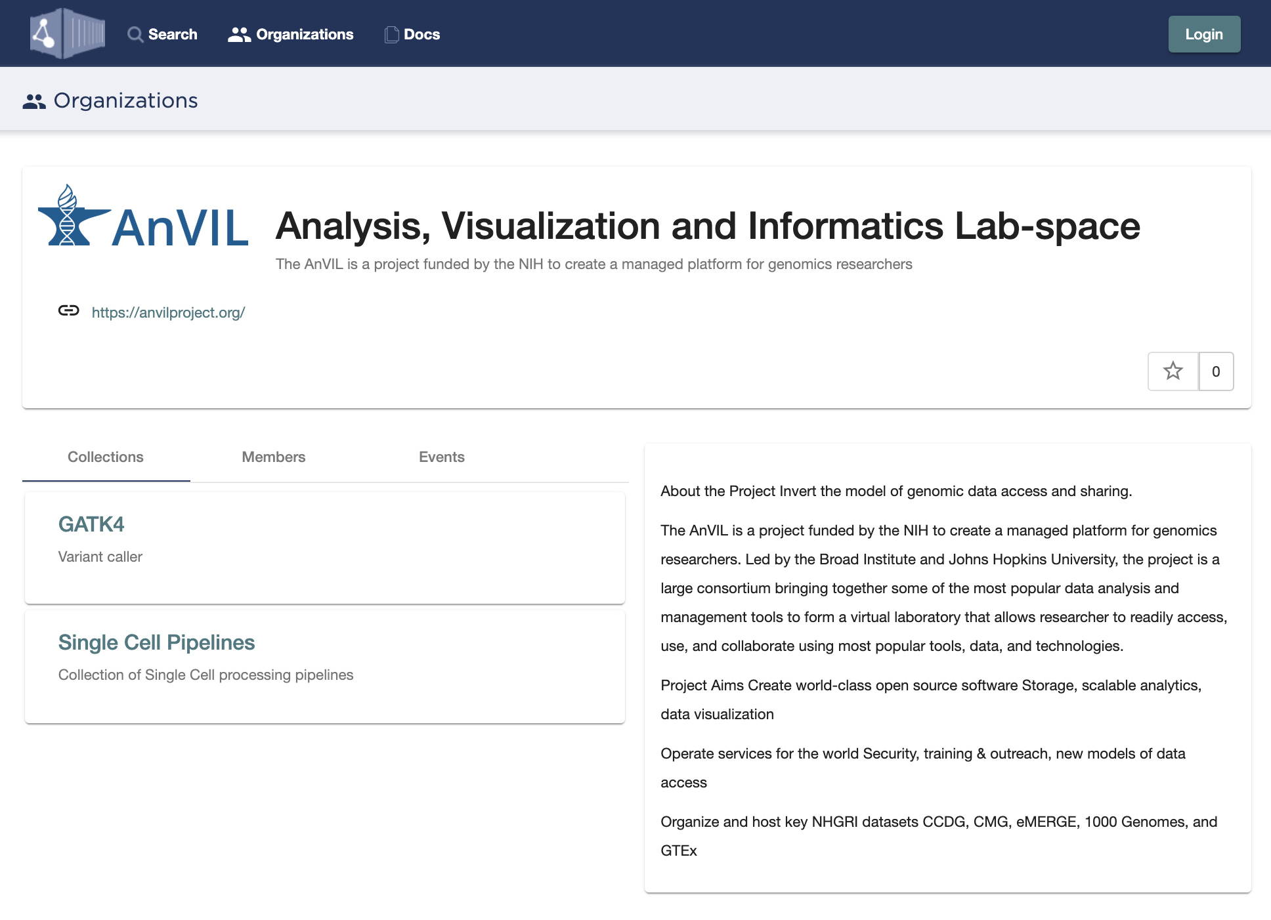
Organizations and Collections
Organizations
A place for groups, labs, consortiums, etc to showcase their projects
Markdown descriptions
Membership roles
Collections
Group of tools/workflows into highlighted by an organization
Markdown descriptions
Notes:
The organizations and collections feature makes it easier for groups to collaborate and showcase their work
For example, a team working together can make a collection of the specific workflows they’re using for a project
This can make sure that collaborators or reviewers are using the proper software versions for that project
Permissions based roles for members of an organization to control for who can edit the page, add others, and create/add to collection

Slide 9
Common Use Case: Simplifying Installation Process
A researcher already knows what software they want to use, but…
Installation problems
Software was built on a different OS (executable files don’t run)
Other problems: compiler or build issues
Dependency problems
Software requires different version than one installed on machine (ex. Java, Python)
Multiple tools need the same dependency, but different versions of that dependency
Notes:
Now that I’ve shown how you can use dockstore for sharing and searching
Let’s go over a more common reason to use Dockstore: which is to simplify installation process
Just as common as findability issues, but definitely more frustrating
So a researcher already knows what software they want use for analysis BUT
They run into a ton of problems installing it for a variety of mysterious reasons
For example the tool was built on a different operating system and doesn’t work
Even compiling the source code runs into multiple errors
Also common: you need to use more than one tool, and they both need the same dependency, but different versions of that dependency.
So how do you manage switching off between the conflicts?
Ex: tools uses Java 8 or python 2.7, but the machine I’m using has java 11 or python 3.6

Slide 10
How It Works: Packaging Content
Container
Descriptor
+
Software is “packaged” using containerization technology and described using descriptor language
Analysis can be moved from cloud-to-cloud, VM-to-VM, server-to-server and yet be guaranteed to run on anything that supports Docker
Notes:
Dockstore solves these problems by the way it packages content.
Software is packaged up in a docker container which includes all the code, dependencies, and operating system required to run the program.
This resolves common installation problems.
The script that outlines how the software is used is written in a descriptor language.
Dockstore currently supports 3 Descriptor Languages: CWL, WDL, and Nextflow.
I’ll go into more detail about containers and descriptors, but the main takeaway here is
That the combination of containers and descriptors makes analysis portable.
You can move from cloud-to-cloud, VM-to-VM, server-to-server and it will be
guaranteed to run on anything that supports docker
*Note: we are currently experimenting with other container technologies like singularity, uDocker, and converting from one to another

Slide 11
Containers, Descriptors, and Parameter Files
Notes:
Let’s go into a more details about Containers, Descriptors, and Parameter Files

Slide 12
Containers, Descriptors, and Parameter Files
Container:
Packaged up code with its all dependencies. This allows for portable software that runs quickly and reliably from one computing environment to another.
Notes:
A container is the packed up code with all its dependencies.
Parameter files completes this picture. This file is where you’ll actually ‘fill in the blanks’ and say use this reference, these bam files, run using this much memory, etc.

Slide 13
Containers, Descriptors, and Parameter Files
Container:
Packaged up code with its all dependencies. This allows for portable software that runs quickly and reliably from one computing environment to another.
Descriptor:
The workflow language used to describe how to run your tool or workflow/pipeline.
Which tools/containers
What steps and when
Define parameters
I/O data
compute requirements
Metadata
Notes:
Emphasize ‘script’ in descriptor.
Programmatic instructions/steps to run the software. (What, when, parameters, etc).
Parameterized values are used in the descriptor so it can act as a template.

Slide 14
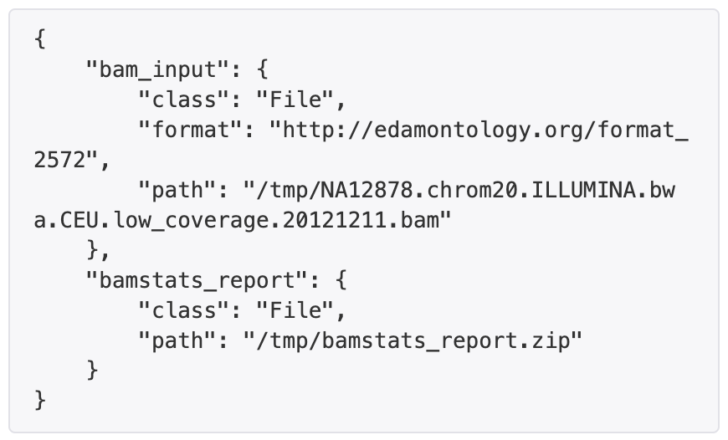
Containers, Descriptors, and Parameter Files
Container:
Packaged up code with its all dependencies. This allows for portable software that runs quickly and reliably from one computing environment to another.
Descriptor:
The workflow language used to describe how to run your tool or workflow/pipeline.
Which tools/containers
What steps and when
Define parameters
I/O data
compute requirements
Metadata
Parameter File (wdl, cwl):
Specifies the actual input/output files (local, ftp, http, or cloud)
Set compute resources
JSON, YAML
Notes:
Parameter files completes this picture. This file is where you’ll actually ‘fill in the blanks’
use this reference genome, these bam files, run using the workflow using this much memory, etc.
Descriptor will say you need to use a bam file for this tool.
Whereas, the parameter file is how you specify use a particular bam file by giving a file path or url

Slide 15
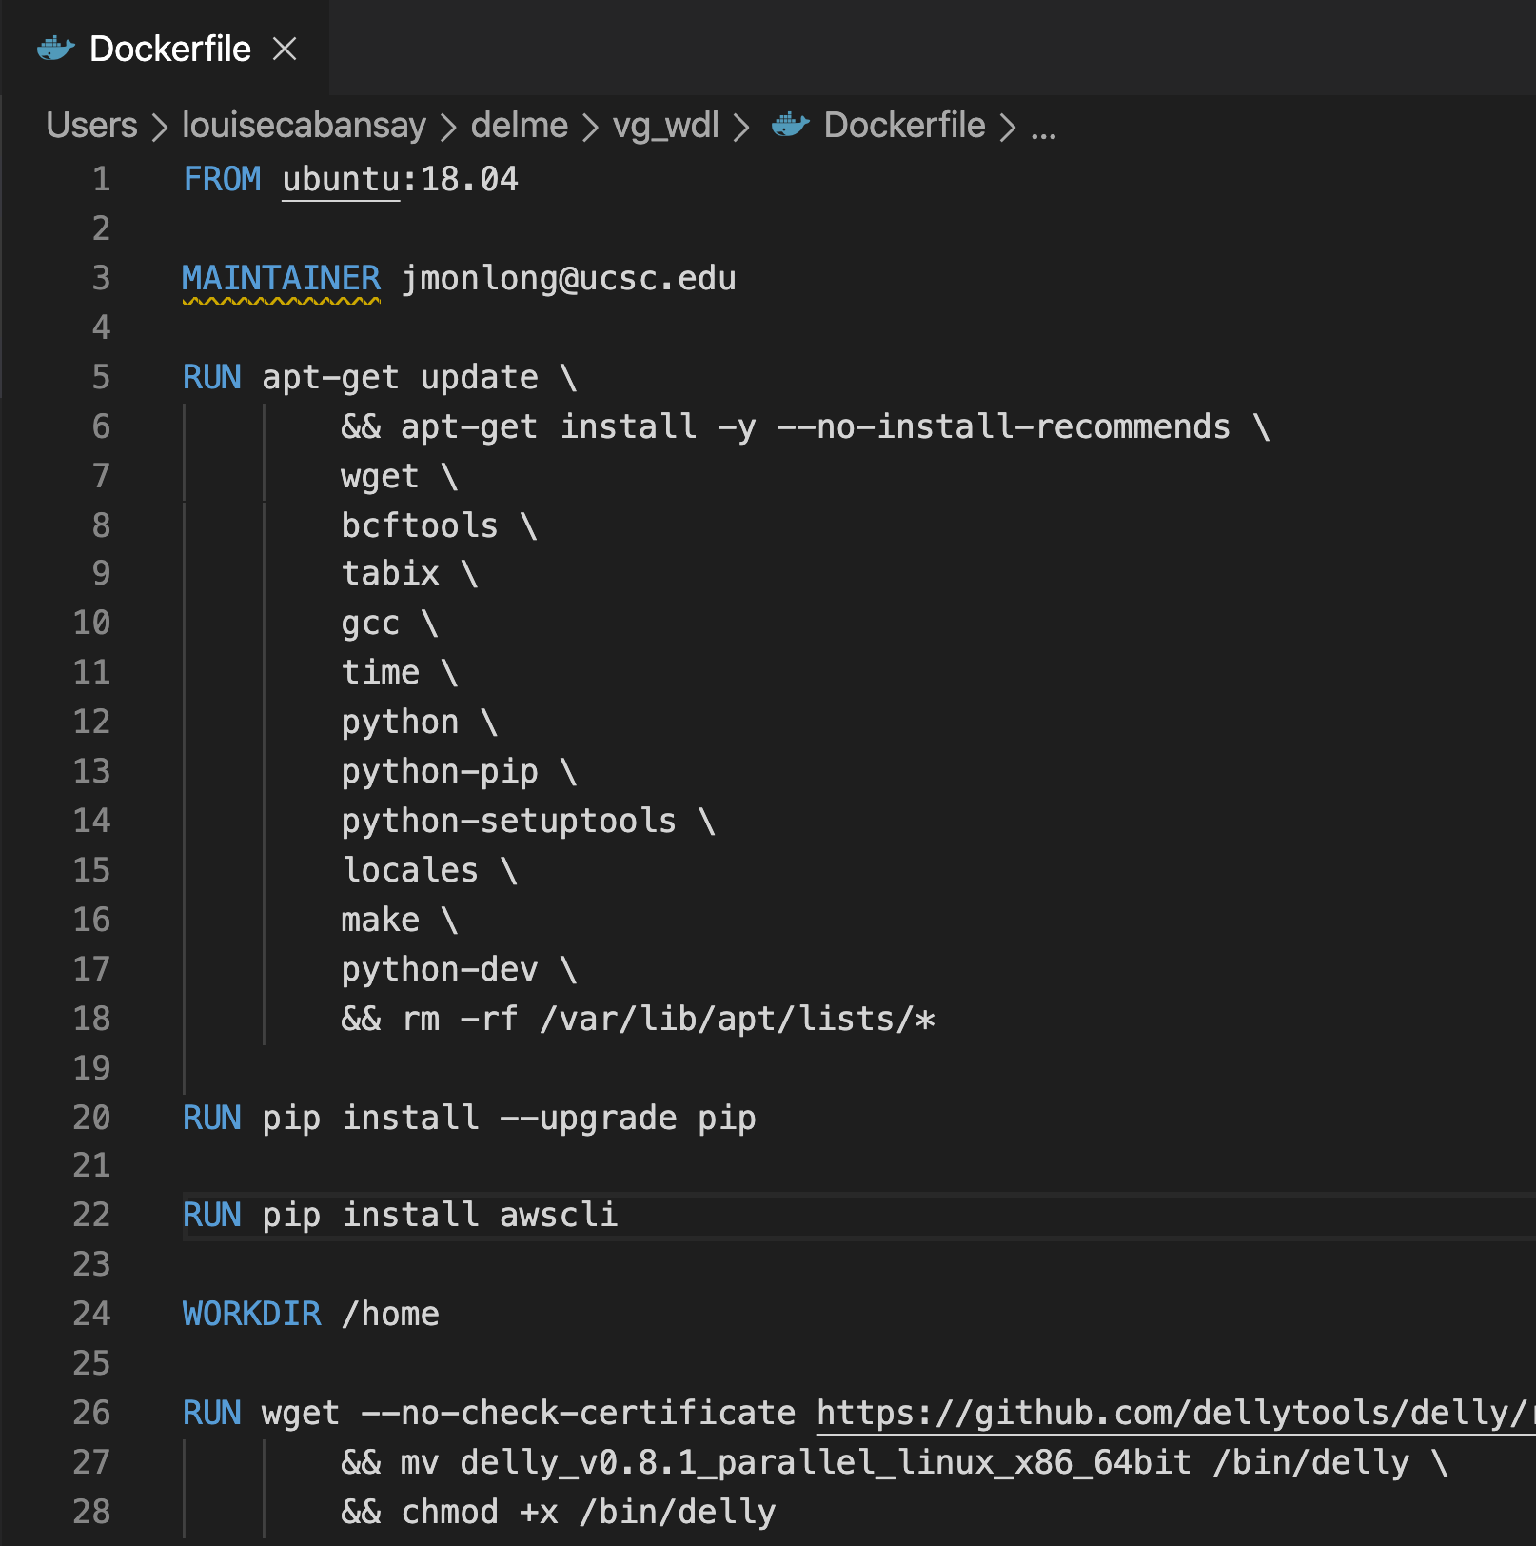
Container Simple Example
Images of containers are built from dockerfiles which describe the packaged up environment:
Operating System or Base Image to build upon
Dependencies to install
Scripts or commands to run to complete environment set- up

Slide 16
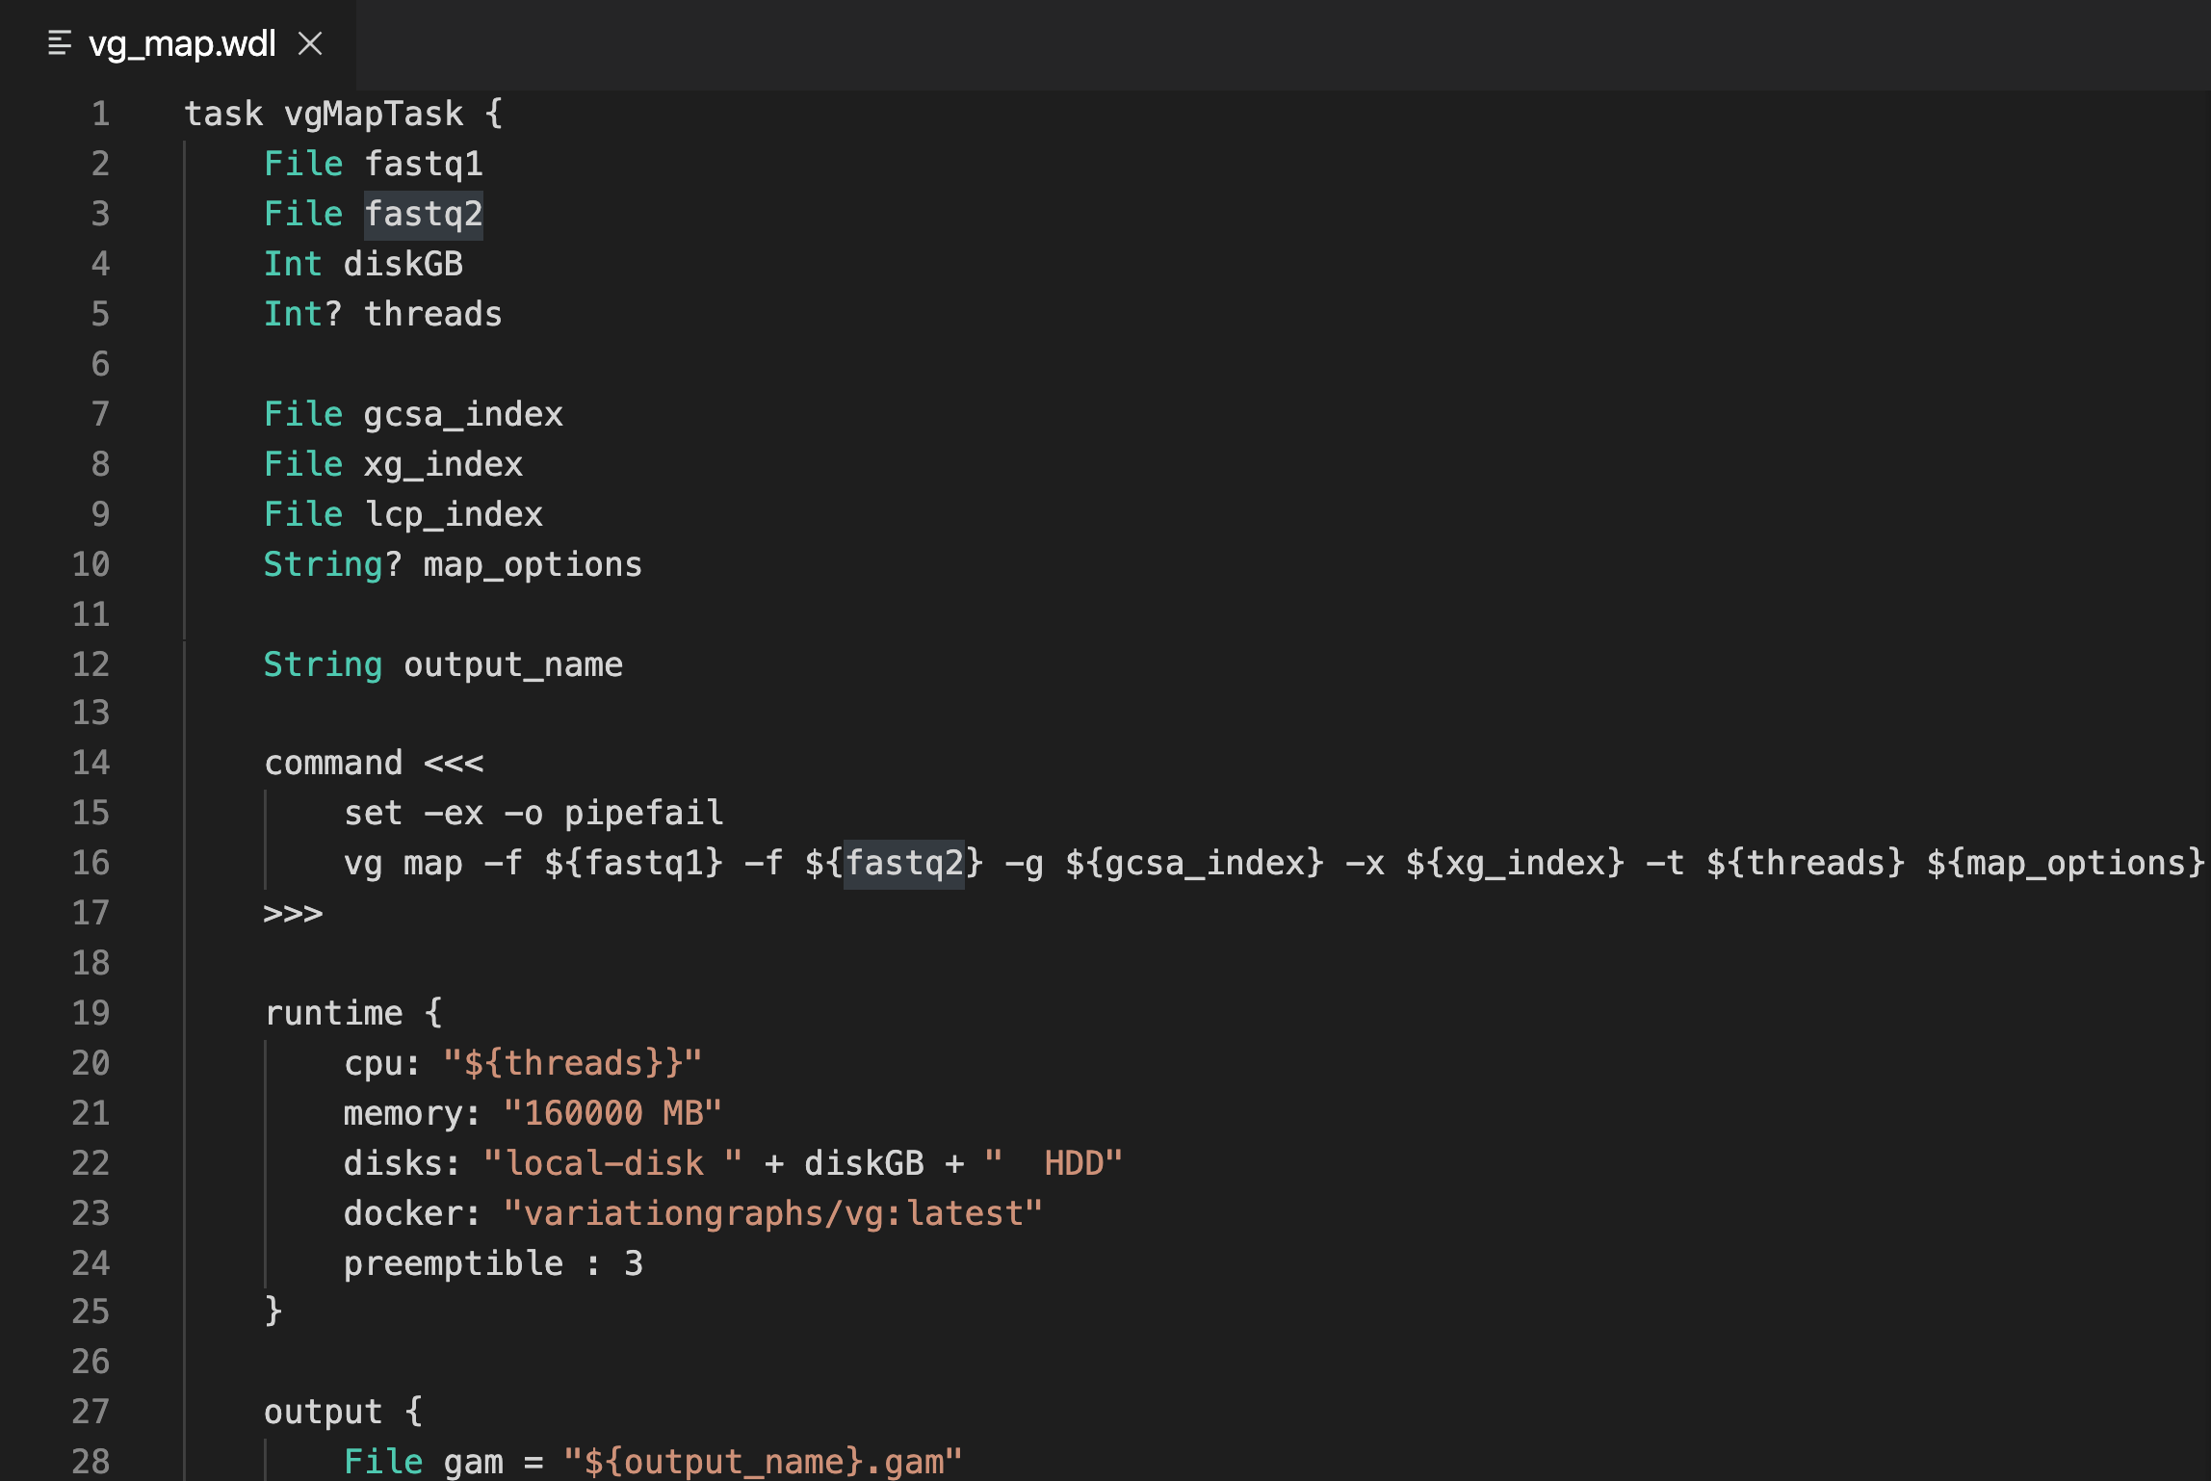
Descriptor Simple Example (wdl task snippet)
Descriptor: A workflow language used to describe how to run your tool or workflow/pipeline.
Define workflow into tasks and what order to run those tasks (aka a script)
Define parameters
Input and output files
Parameterized commands
Compute requirements
Metadata
Authorship, contact information, etc

Slide 17
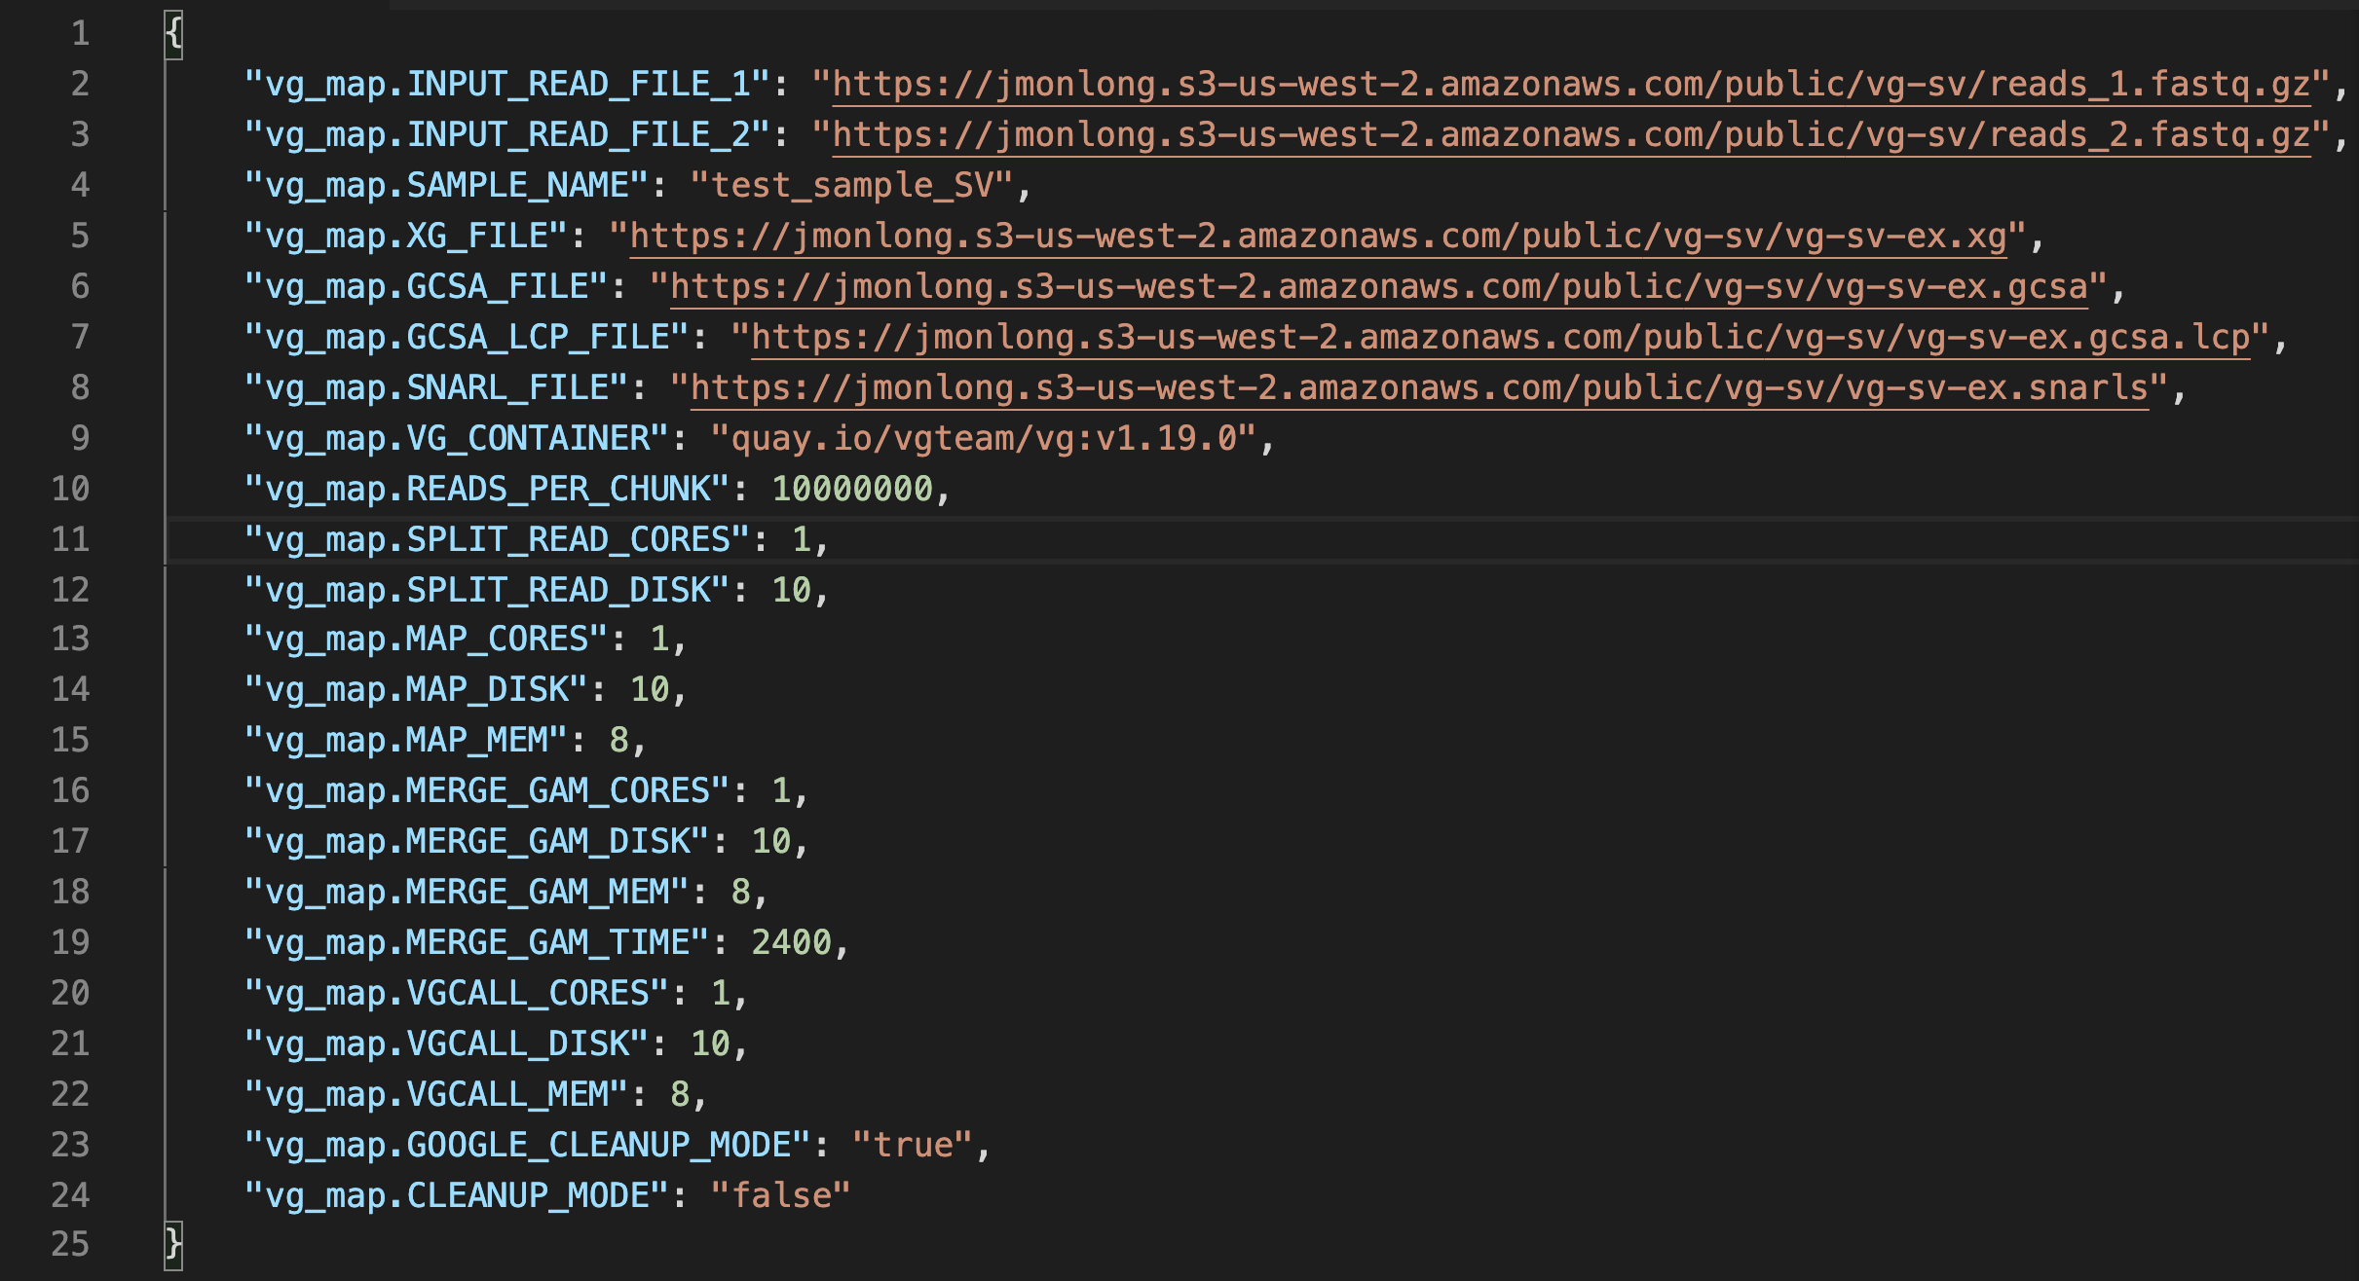
Parameter File Simple Example:
Specify the actual input and actual files/values to use when running tasks
File provisioning plug-ins allow for data to be fetched from cloud storage (s3, gs, etc.)

Slide 18
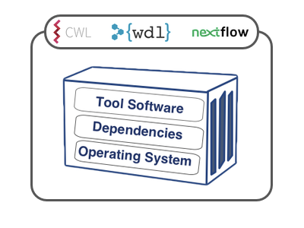
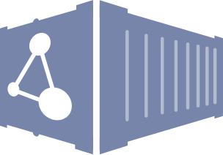
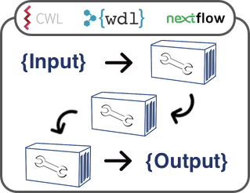
Ways to Register to Dockstore
(A) Automated builds using quay.io and the source control repos triggering them
Containerized Tool
Descriptor
+
Dockerfile
Build
System
Docker image
(B) Retrieve workflow and tool descriptors from external source control directly
Workflow:
Tools + Descriptor
External Hosting
(B/C) point to docker image(s) on quay or dockerhub
Dockstore Registration
(C) Store workflow descriptors on dockstore.org
Host on Dockstore.org
Notes:
For the visually inclined,
Here’s a summary diagram of the many ways to register your Tool or Workflow into Dockstore
This diagram is more directed at a workflow developer rather than an end user. We’ll cover the details of this process in a future webinar.

Slide 19
Complex Use Cases: Collaborations and Scale
Ex: A team of collaborators from 8 different institutions are working together on a study that analyzes the genomes of thousands of individuals. But…
Each institution uses a different compute environment for analysis
Workstations, local machines, or small servers for development
Large analysis on various cloud platforms or different custom HPCs
Pipeline/Script is designed to work for one institution’s data but can’t easily be interchanged or doesn’t scale properly at another
Everything seems to have installed, but the output differs between compute environments
Notes:
These building blocks are the dockstore fundamentals that let us tackle more complex use cases
The ones that arise is large scale collaborations or when we increase the scale of data

Slide 20
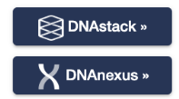
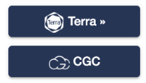
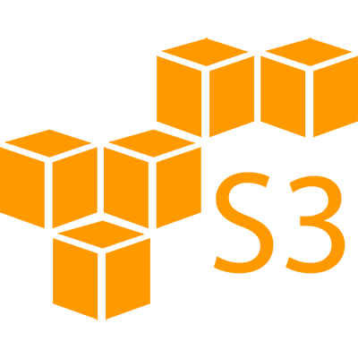
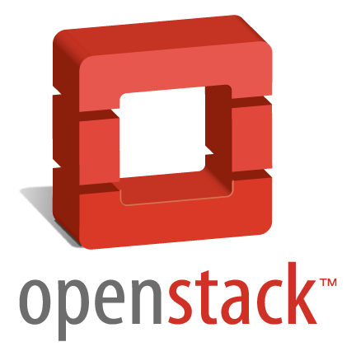
Solution: Interoperable Cloud Ecosystem
Dockstore CLI
Execution Environment
Data
Standardized APIs allow Dockstore to connect to a variety cloud execution and data storage environment
Notes:
Dockstore GA4GH Standard APIs
Current platforms are DNAstack, DNAnexus, Terra, CGC

Slide 21
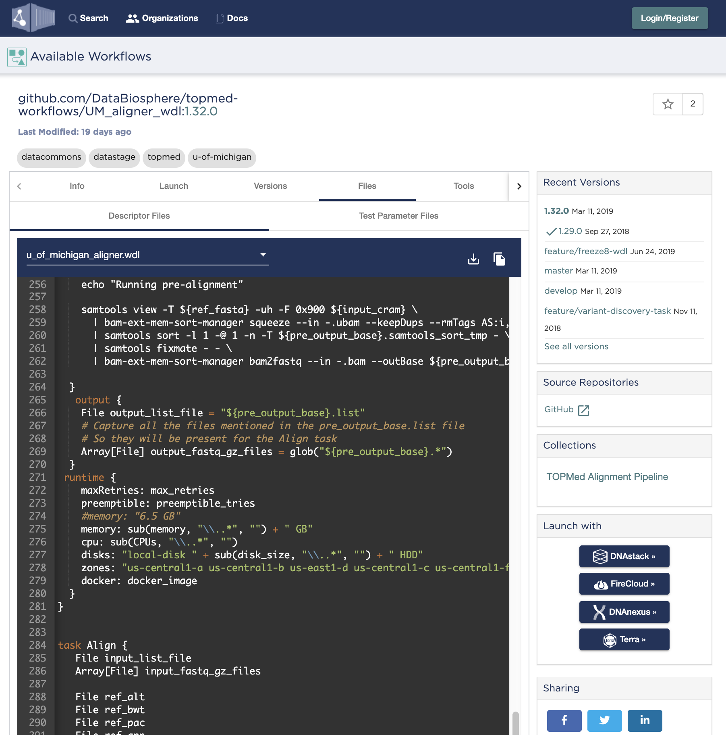
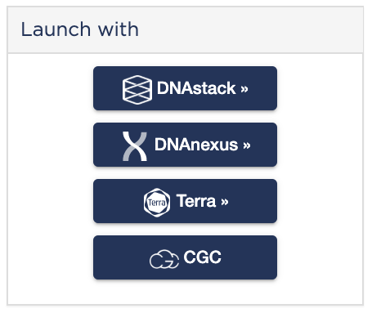
Launching Analysis
Partner Platforms
DNAstack
DNAnexus
Terra
CGC : Cancer Genomics Cloud (Seven Bridges)
BioData Catalyst
Notes:
Figures aren’t updated here, but we now have BDCatalyst and AnVIL launch buttons to send workflows into those respective workspaces

Slide 23
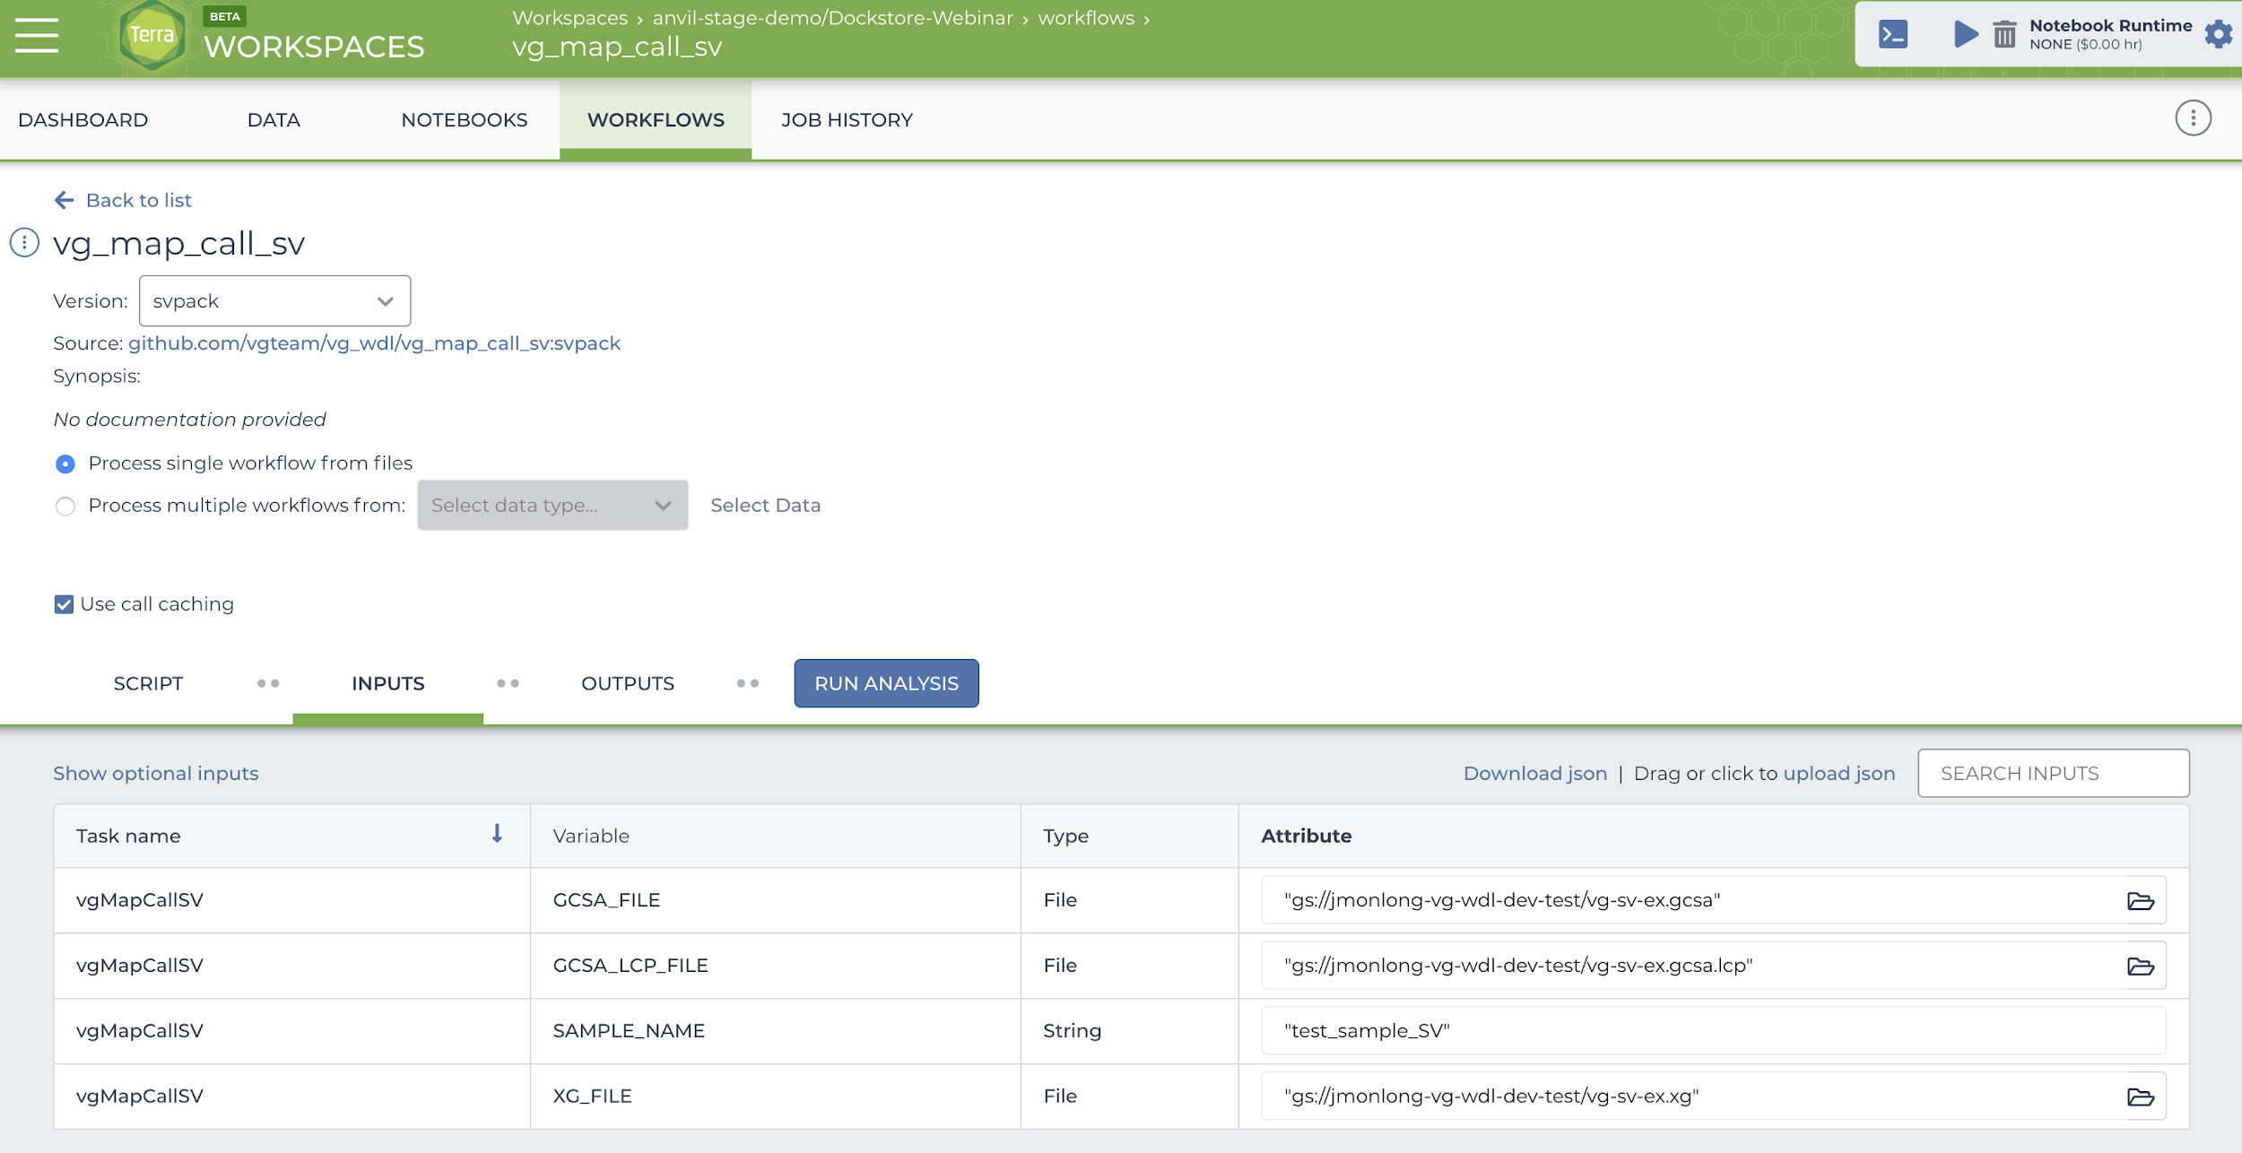

Slide 24
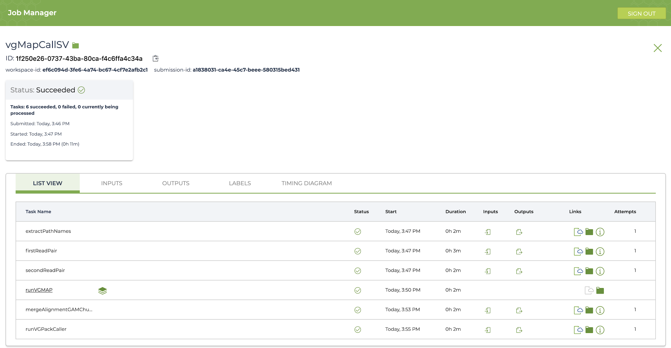

Slide 25
Dockstore CLI
A handy command line resource for users to run content locally
Pulls tool/workflow from dockstore
File provisioning
Execute locally with Cromwell or CWLtool
dockstore workflow launch --entry github.com/vgteam/vg_wdl/vg_map_call_sv:svpack --json parameter.json
Execution with the Dockstore Command Line Interface (CLI)
provision input files
stage CWL/WDL
execute with Cromwell /CWLtool
provision output files
Simple Dockstore Command Line
Notes:
dockstore workflow launch --entry github.com/vgteam/vg_wdl/vg_map_call_sv:svpack --json vg-run-mini.json

Slide 26
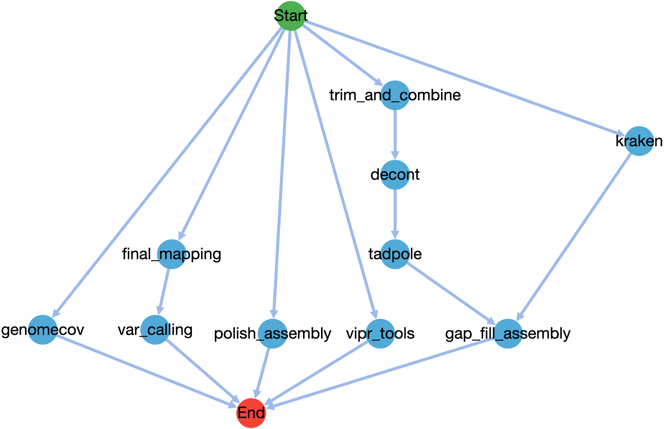
Other Dockstore Features
Language Support
Syntax Highlighting and Validation
DAG visualization
Snapshot and DOI generation
Freeze workflow versions using our new snapshot feature
Request DOIs for frozen workflows via Zenodo to use as publication references
Prototype for Apps and Services now public!

Slide 27
Brief Developer Details

Slide 28
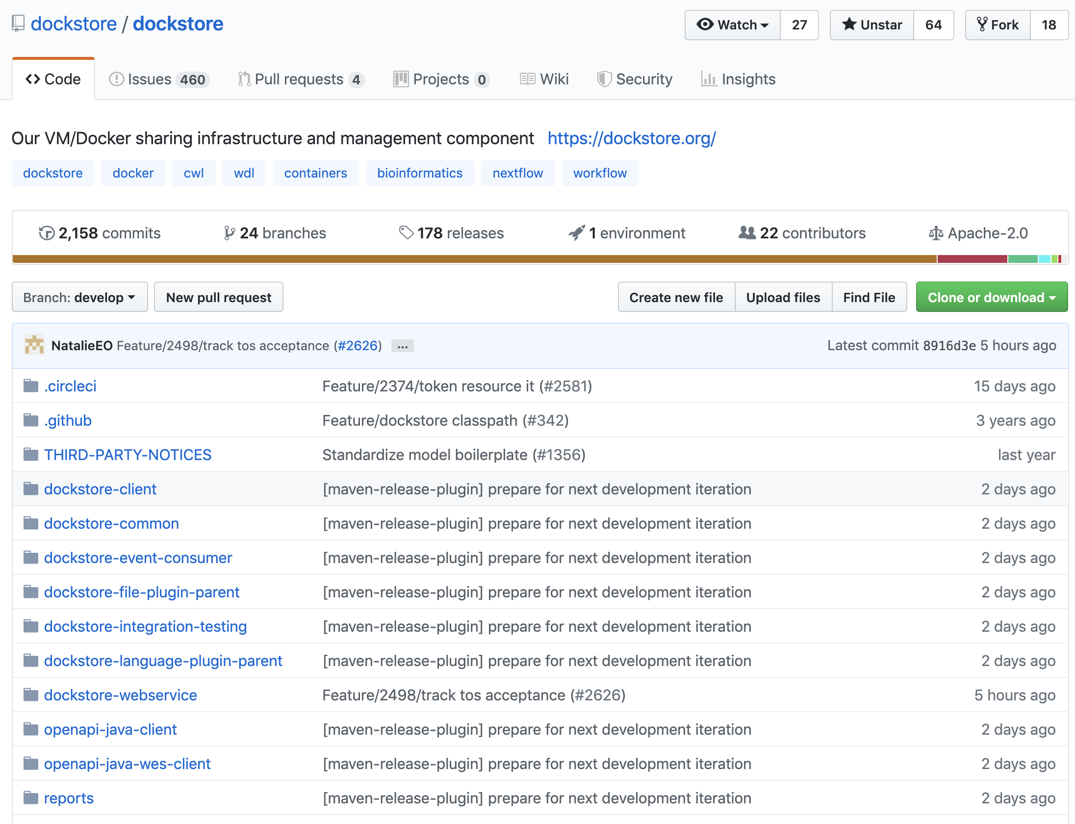
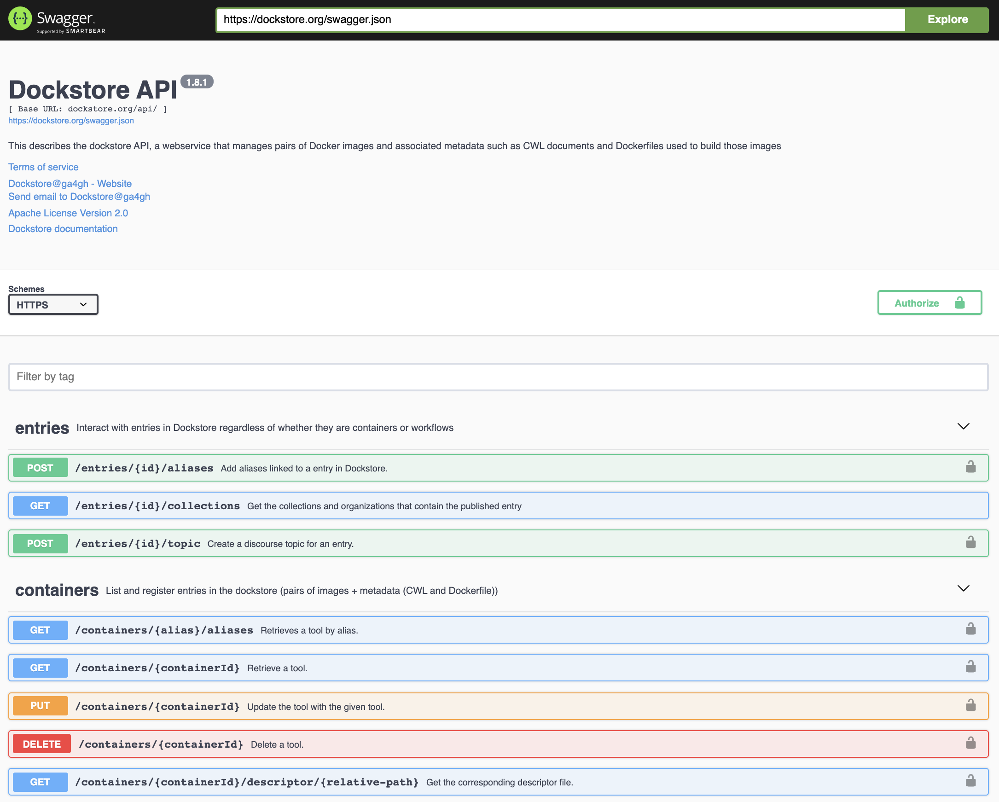
Source Code and API
https://dockstore.org/
Github: https://github.com/dockstore/dockstore
Swagger: https://dockstore.org/api/static/swagger-ui/index.html#

Slide 29
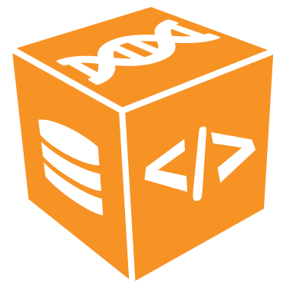
GA4GH Tool Registry Service (TRS) API
The Global Alliance for Genomics and Health (GA4GH) Tool Registry API standard for listing and describing available tools for exchange, indexing, and searching.
Dockstore implements TRS for launching tools/workflows into external analysis platforms
Sharing API
/api/ga4gh/v2/tools/{id}/versions/{version_id}
GET
or
GET
/api/ga4gh/v2/tools
Containerized Tool
+ Descriptor
Workflow: Tools + Descriptor
GitHub page: https://github.com/ga4gh/tool-registry-service-schemas
Latest draft release: 1.0.0, working on 2.0.0 now
Notes:
---
Through collaboration with Global Alliance for Genomics and Health Dockstore helped draft the Tool Registry Service (TRS) API standard.
TRS defines a minimal, common read-only API for listing and describing tools or workflows located in a given registry so that those entries can be exchanged, indexed, or searched by other services
TRS V1 vs V2:
Conversion of syntax to better support Javascript tooling and better match other GA4GH cloud workstream APIs
Changes to better support other container types (ex Singularity and other Docker alternatives)

Slide 30
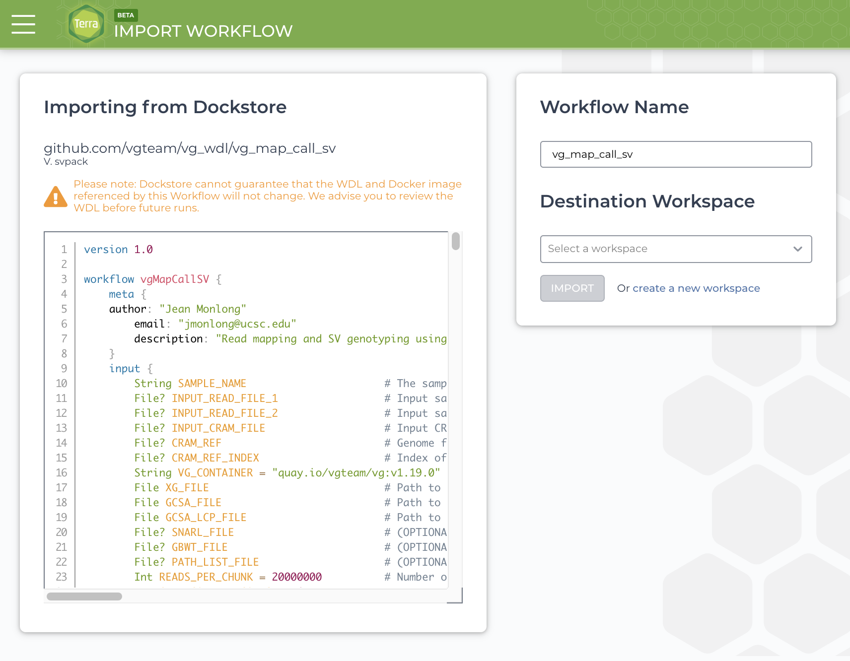
Importing workflows to Terra using TRS
Notes:
Terra uses V1 TRS endpoints shown to import a workflow from Dockstore
Caveat, right now test parameters files are not brought in during import

Slide 31
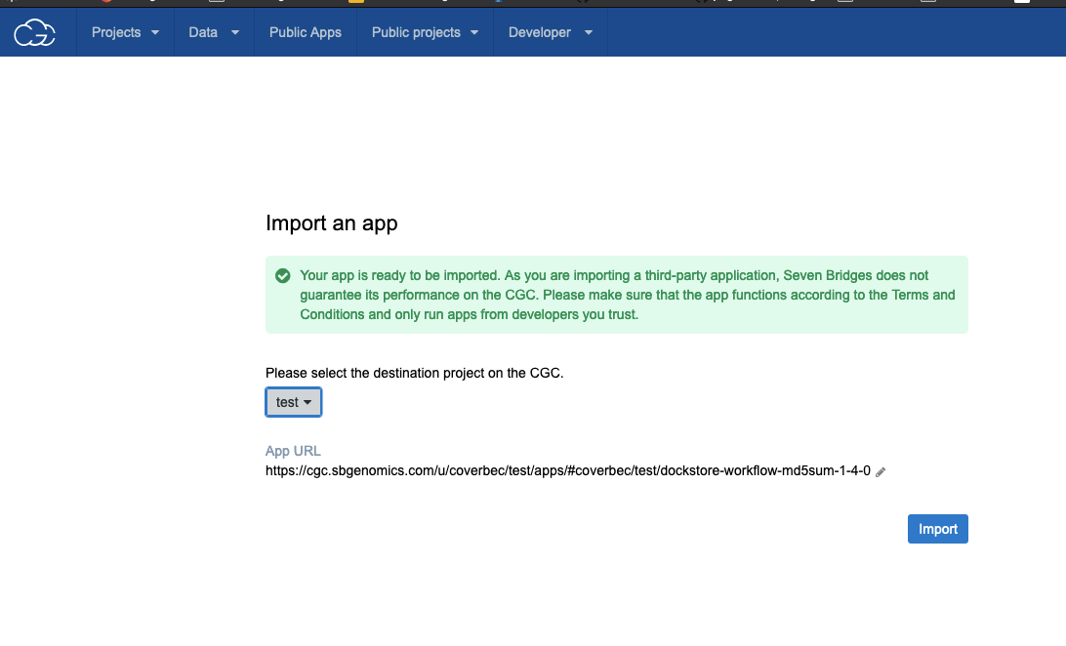
Importing to Seven Bridges Cancer Genomics Cloud w/ TRS

Slide 32
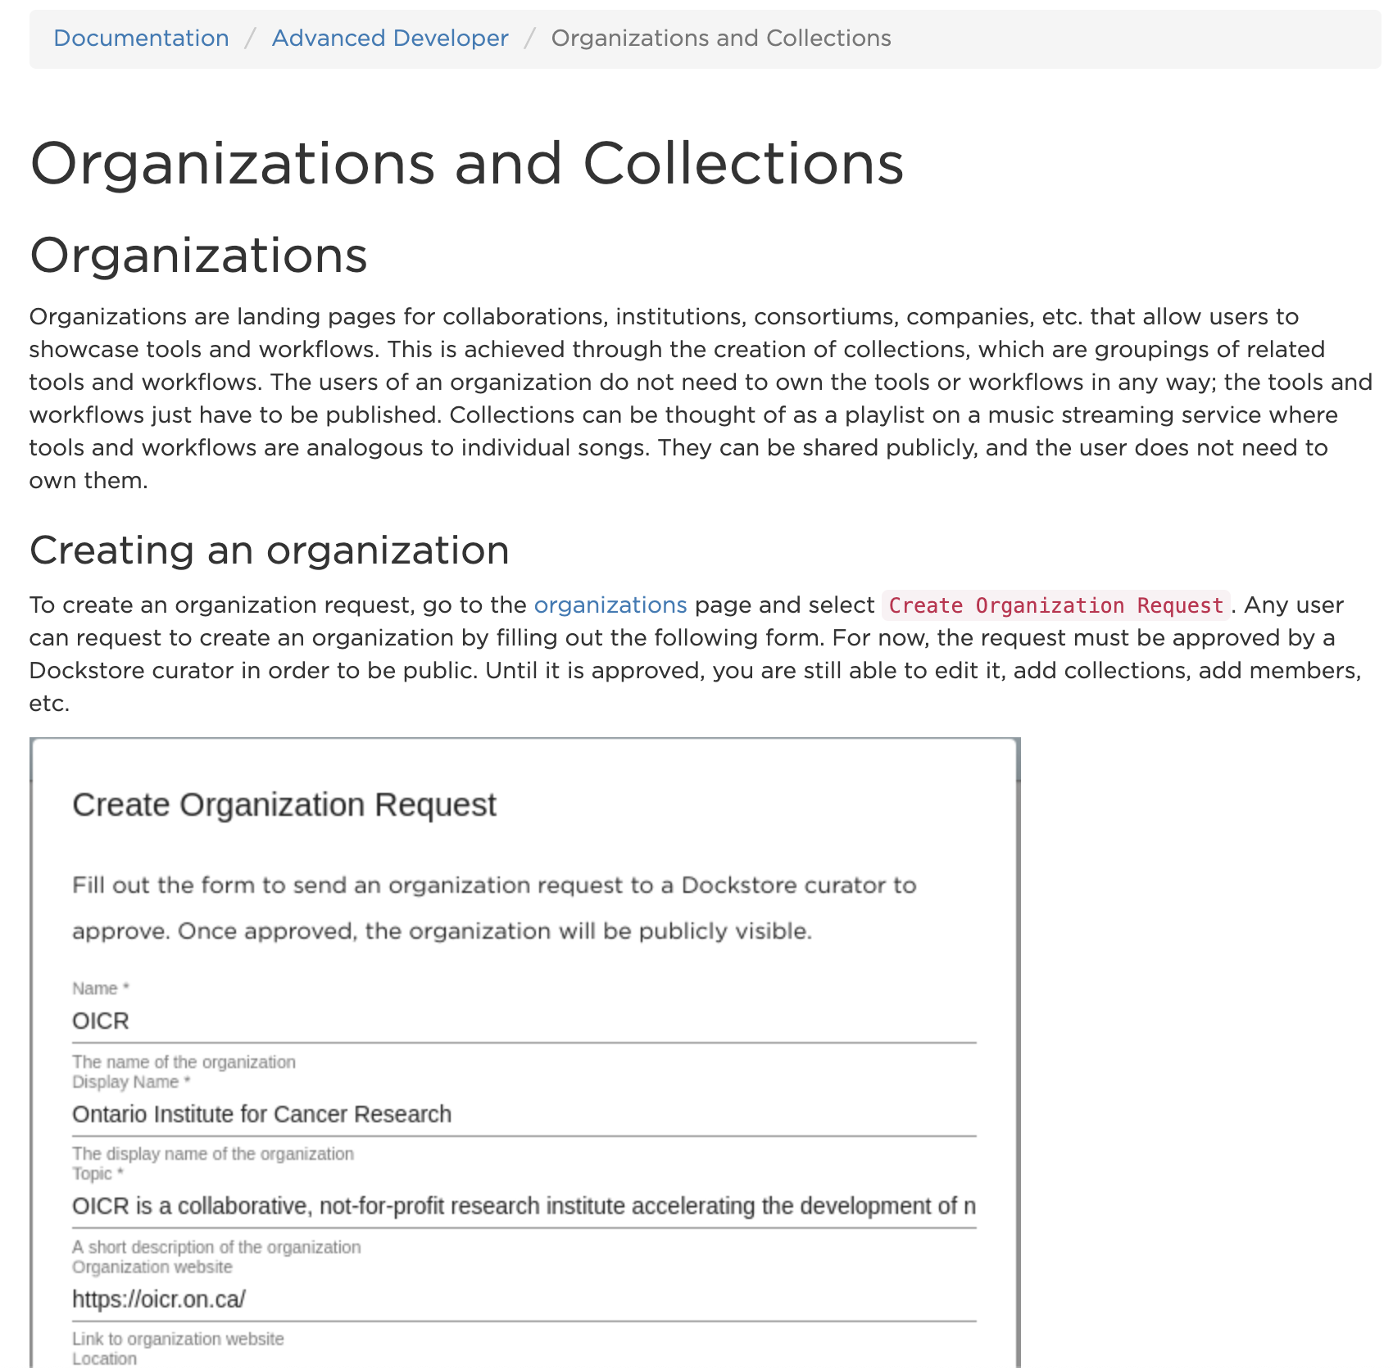
Documentation and Tutorials
Example Topics:
Getting Started With…(Docker, Nextflow, CWL, WDL)
Launching Tools and Workflows
Writing checker workflows
Developing File Provisioning Plugins
Creating Organizations
And many more!
https://docs.dockstore.org/

Slide 33
Next Release (1.9.0)
1.9.0 - couple months
Workflow registration via GitHub Apps
First phase of Galaxy support
Continuing performance, security, and usability
GA4GH Tool Registry Service TRS v2
Workflow lifecycle improvement -- archiving
Refine services schema
2020 Roadmap Highlights
Galaxy - workflows and launch
Continuing development and roll out of Apps and Services
Linking ORCID accounts
More details see full roadmap
Notes:
Should Cover:
1.7.0 features
Services: genome browsers, notebooks, and reference data providers
Github Apps migration
Immutable
DOI

Slide 34
The Dockstore Team
Lincoln Stein
Denis Yuen
Andrew Duncan
Gary Luu
Kathy Tran
Brian O’Connor
Benedict Paten
Cricket Sloan
Charles Overbeck
Walt Shands
David Steinberg
Louise Cabansay
Natalie Perez
Melaina Legaspi
Emily Soth
Andy Chen

Slide 35
Acknowledgements
Funded by:
This work was funded by the Government of Canada through Genome Canada and the Ontario Genomics Institute (OGI-168).

Slide 36
Extra Slides for Q&A

Slide 37
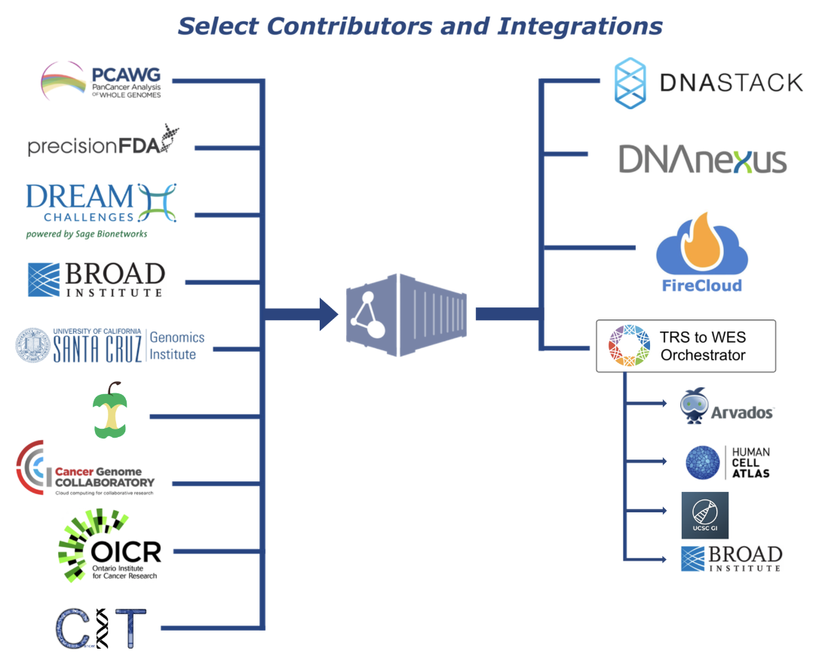
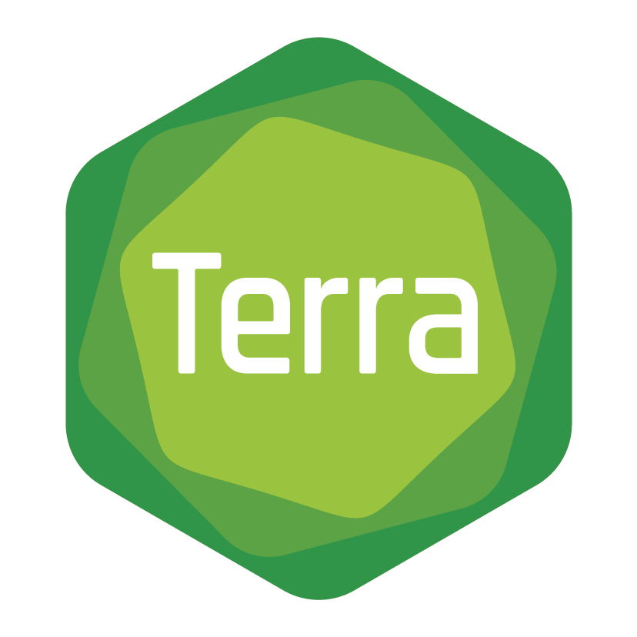
Dockstore Ecosystem
Dockstore is thankful to its many contributors, users, and partners. This community has pulled together a library of over 450 tools and workflows. In the diagram to the right we’ve highlighted a few select contributors to give a sense of what has been occuring in this space.
Notes:
Here’s a helpful diagram that showcases

Slide 38
TRS V1 vs TRS V2
Breaking Changes
Conversion of syntax to better support Javascript tooling and better match other GA4GH cloud workstream APIs
Removal of protobuf support
Changes to better support other container types (ex Singularity and other Docker alternatives)
Allow for multiple container images, multiple authors, multiple verification sources for versions of tools
Substantial Changes
Addition of Nexflow as a descriptor format
/tools/{id}/versions/{version_id}/{type}/files added to describe all available files a tools
Checker workflows
Process for auto-generation of OpenAPI3 copy of the schema
More information: https://ga4gh.github.io/tool-registry-service-schemas/

Slide 39
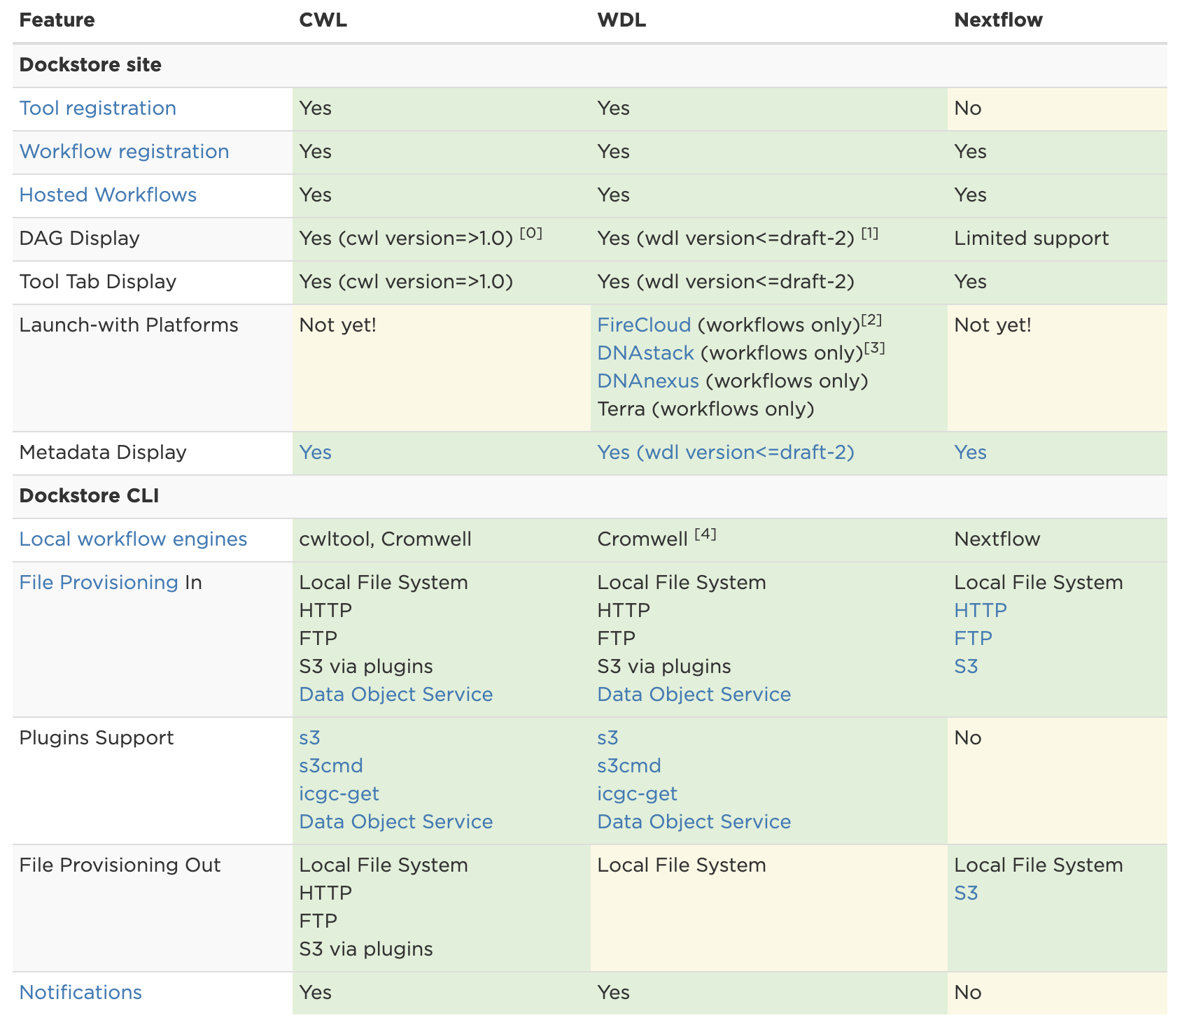
Language Support
More info:
https://docs.dockstore.org/docs/user-tutorials/language-support/

Slide 40
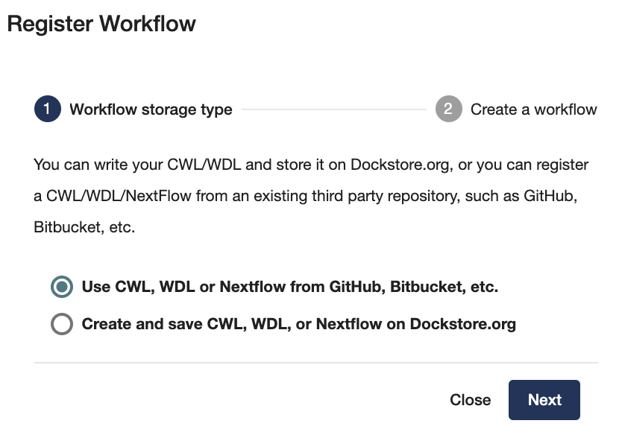
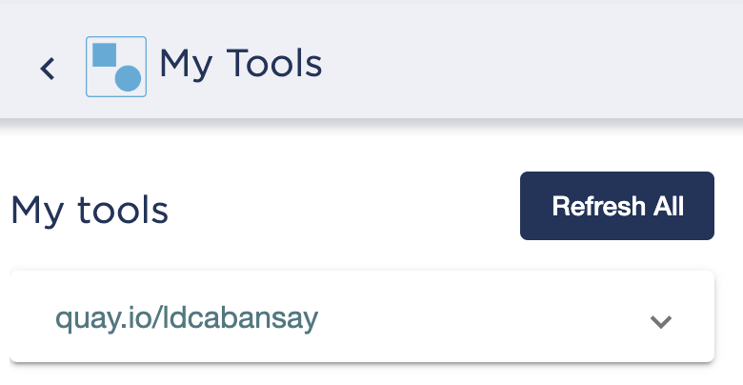
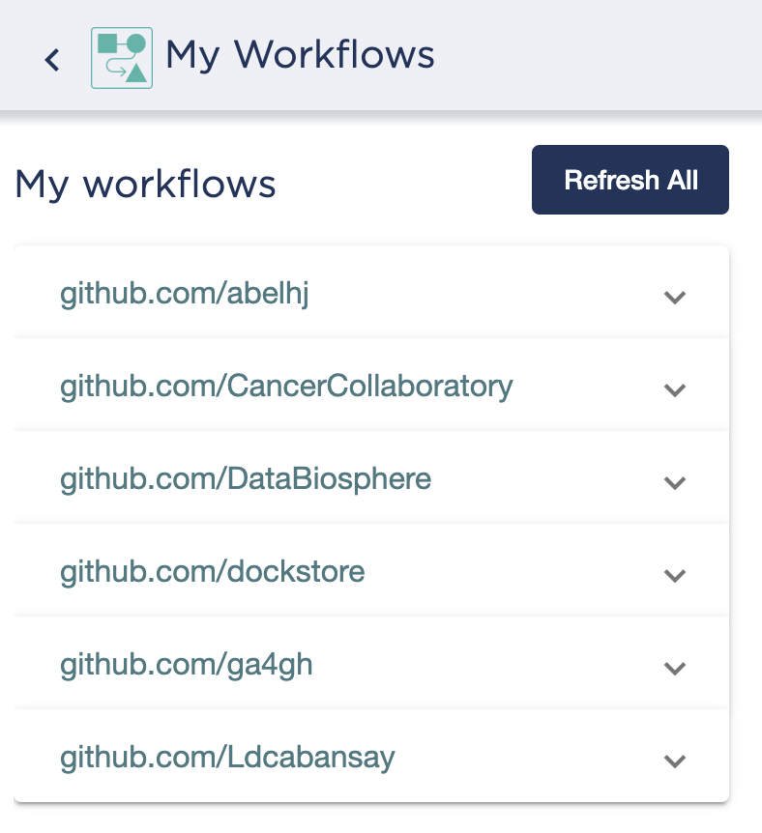
Ways to Register to Dockstore
Through linked account via supported public APIs
OR through manual registration pointing to external source repo or directly on Dockstore.org
Notes:
Linked accounts will auto populate MyTools/Workflows Page, and detect automated builds and tags/versions like on quay
Can also manually register

Slide 41
Ways to Register to Dockstore
(A) Automated builds using quay.io and the source control repos triggering them
Containerized Tool
Descriptor
+
Dockerfile
Build
System
Docker image
(B) Retrieve workflow and tool descriptors from external source control directly
Workflow:
Tools + Descriptor
External Hosting
(B/C) point to docker image(s) on quay or dockerhub
Dockstore Registration
(C) Store workflow descriptors on dockstore.org
Host on Dockstore.org
Notes:
For the visually inclined,
Here’s a summary diagram of the many ways to register your Tool or Workflow into Dockstore
This diagram is more directed at a workflow developer rather than an end user. We’ll cover the details of this process in a future webinar.

Slide 42
Content: Tool vs. Workflow
Tool
Workflow
OR
Container + Descriptor
Workflow: Tools + Descriptor
A workflow can have multiple containerized tools wrapped in a descriptor
A tool is single container wrapped in a descriptor
Notes:
Let’s get more specific about how this packaging looks like with an example.
First, content on Dockstore is available in two types:
Tool
Workflow
A tools is a single container described a descriptor
Alternatively, a workflow can have multiple containerized tools plus a descriptor

Slide 43
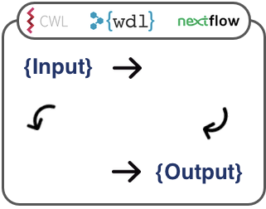
Content: tool vs workflow (example)
Tool
Workflow
BWA-MEM
Variant Calling Pipeline
Debian OS
binaries
C
GNU Make
GCC
zlibs
OR
processing
alignment
call variants
A workflow can have multiple containers wrapped in a descriptor and performs multiple tasks.
A tool is single container with a descriptor that performs a single task.
Notes:
An example of a tool would be something like BWA-MEM
The docker container will have all the requirements to run the BWA-MEM software
An example of a workflow would be more similar to a variant calling pipeline
Multiple tools for each step and can subsequently use multiple containers
The tools required for each step can be packaged in their own containers.
A descriptor is still used to describe a workflow.

Slide 44
Dockstore & GA4GH Cloud Workstream
Containerized Tool + Descriptor
CWLtool
Arvados
TOIL
TRS
lambda+Cromwell
Cromwell
WES
Workflow: Tools + Descriptor
Orchestrator
DRS
Notes:
Here’s a visualization of the Dockstore ecosystem and how it fits into the GA4GH cloud workstream
talk about how dockstore integrates with analysis environments through TRS-WES API standards

Slide 45
Collaborations - The Commons Alliance and Other Projects
NHLBI Data STAGE
NHGRI AnVIL
And Many Others
Dockstore will serve as an official workflow provider for the Commons Alliance, a common infrastructure collaboration to facilitate combining Data + Cloud Compute

