Slide 1
“Train your colleague” remote training session (17MAR20)
The four stacks involved
AnVIL (NHGRI), BioData Catalyst (NHLBI), Cancer Research Data Commons (NCI), Gabriella Miller Kids First - Data Resource Center (CF)
Framing
The four platforms have similar goals and user bases. It benefits our users and the biomedical research community to make the data and tools on our platforms widely available by interconnecting our platforms.
Goals
Understand the components of the four platforms and how users flow through the platforms.

Slide 2
Kids First Data Resource Center
Vision and DRC Participants
Data Available
Gabriella Miller Kids First Vision: Alleviate suffering from childhood cancer and structural birth defects by fostering collaborative research to uncover the etiology of these diseases and supporting data sharing within the pediatric research community.
DRC Funder: NIH Common Fund’s Gabriella Miller Kids First Pediatric Research Program; administered by NHLBI (PO: Charlene Schramm) overseen by NIH Kids First Working Group.
DRC PIs: Adam Resnick, Brandi Davis-Dusenbery, Vincent Ferretti, Robert Grossman, Allison Heath, Deanne Taylor, Sam Volchenboum
DRC Institutions: Children’s Hospital of Philadelphia, CHU Sainte-Justine, University of Chicago, Seven Bridges Genomics
Go Live Date: September 10, 2018
Kids First Released Datasets (7,223 participants):
Congenital Heart Defects (2,133)
Orofacial Cleft - European Ancestry (1,295)
Ewing Sarcoma - Genetic Risk (1,047)
Syndromic Cranial Dysinnervation (801)
Orofacial Cleft - Latin American (804)
Congenital Diaphragmatic Hernia (581)
Disorders of Sex Development (300)
Adolescent Idiopathic Scoliosis (262)
~24,000 additional participants approved for WGS sequencing as part of Kids First
Interoperable Datasets (1,677 participants):
TARGET: Neuroblastoma (274)
TARGET: Acute Myeloid Leukemia (321)
Pediatric Brain Tumor Atlas: CBTTC (912)
Pediatric Brain Tumor Atlas: PNOC (33)
OpenDIPG: ICR London (137)
Cavatica enables “bring your own” data
NCI CDS and NCBI SDDP Interoperability coming

Slide 3
Kids First Data Resource Center
Clinical/Phenotypic Data Interop Pilot Opportunities
Interoperability Use Cases
We have a number of researchers that will be working across datasets in multiple platforms. In general, pediatrics and developmental biology spans organs, disease and data types - making effective and sustained interoperability a critical need.
Examples of overlapping cohorts:
INCLUDE: KFDRC and DataSTAGE
PCGC: KFDRC and DataSTAGE
CMG: KFDRC and AnVIL
CSER: KFDRC and AnVIL
NBL: KFDRC and NCI CRDC
AML: KFDRC and NCI CRDC
Brain Tumors: KFDRC and NCI CRDC
Early on, we realized we needed “intra”-operability for releases and developed a release coordination protocol. Perhaps an area for interoprability as well.
Clinical and phenotypic data has been identified as a limiting factor across supported studies. The wide range provides challenges, but also opportunities for interoperability. Areas under investigation include:
FHIR as a core standard
Terminologies for harmonized and computable data values
Identifying virtual cohorts across the platforms based on clinical and phenotypic data
Workflows for clinical/phenotypic data harmonization

Slide 4
Kids First Data Resource Center
Tools Available
Authentication, Authorization and Indexing
Kids First DRC workflows
Goal: functional equivalency to other large datasets/resources
bwa-mem based alignment with GRCh38
Germline:
Trio/family-based GATK germline best practices, GATK genotype refinement
Somatic:
Strelka2, Mutect2, Lancet, VarDict, Manta, Control-FREEC
RNA-Seq:
STAR 2-pass, RSEM, Kallisto, STAR-fusion, Arriba
Cavatica
Over 300 public apps, interactive analysis with Jupyter Notebooks and RStudio
Over 200,000 workflows run on Cavatica since KFDRC go live
Integration with PedCBioPortal
Open access visualization and analysis of somatic mutations, expression, proteomics
Variant warehouse development underway
Authentication:
Controlled access: eRA Commons
Registered access: Google, Facebook and ORCiD (OAuth2)
Authorization:
NIH Datasets:
Telemetry reports from dbGaP either to Kids First Framework Services or NCI CRDC Framework Services
Consortium Datasets:
Whitelist via Gen3 (also eRA Commons AuthN)
Indexing:
The Kids First Data Service integrates with Gen3 indexd to index and associate relevant data for querying to the files. Cavatica also recently released GA4GH DRS endpoints for all files.

Slide 5
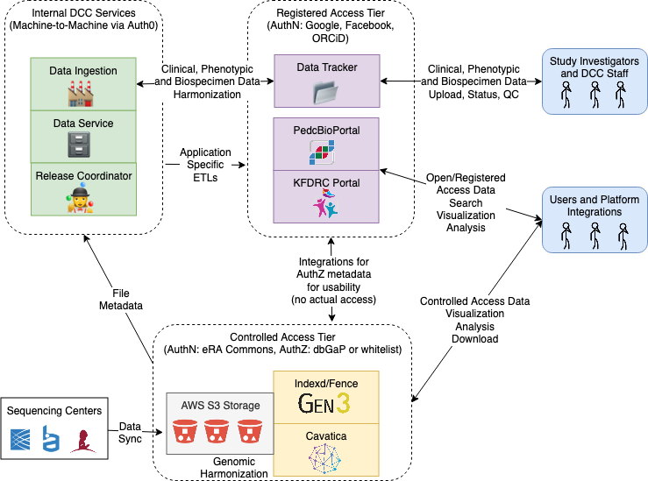
Kids First Data Resource Center
Architectural Diagram - Technical
https://github.com/kids-first/

Slide 6
NHLBI BioData Catalyst
Project Description
Participants
The NHLBI DataSTAGE project (Storage, Toolspace, Access and analytics for biG data Empowerment) aims to develop a cloud-based platform using FAIR principles to advance Heart, Lung, Blood, and Sleep research, building tools and workflows that enable investigators engaged in mining large, high-value
datasets. The goal is to democratize data and compute access, while ensuring appropriate data security, to accelerate efficient biomedical research and maximize community engagement, productivity, and discovery.
Initial Go Live Date: January 2020
Funder: National Heart, Lung, and Blood Institute, Gary Gibbons (Director), Alastair Thomson (CIO), Jon Kaltman (Program Officer)
PIs: Ahalt, Avillach, Boyles, Bradford, Davis-Dusenbery, Krishnamurthy, Grossman, Paten, Philippakis, Thessen
Institutions: The Broad Institute, University of Chicago, University of California, Santa Cruz, Harvard Medical School, Berkeley Lab, Oregon State University, RTI International, University of New Mexico, UNC-CH/RENCI, Seven Bridges Genomics, Elsevier, Repositive, Veterans Affairs

Slide 7
NHLBI BioData Catalyst
Data available
Tools available
DataSTAGE is being designed to support workflows for batch data analysis, notebooks for interactive analysis, and apps/services for web apps. Users can bring their own workflows and notebooks.
Workflows
DataSTAGE supports workflows written in CWL and WDL. Highlights include workflows from the DCC and TOPMed alignment and variant calling.
Notebooks
RStudio and Jupyter Notebooks are supported with examples leveraging DataSTAGE for image visualization, machine learning, and GPU acceleration.
Apps/Services
DataSTAGE will support services such as the PIC-SURE API and web apps like i2b2/tranSMART and the Bravo browser.
Current/near-term:
- 145,753 whole genome sequences on platform - 56,379 whole genome sequences available to users under controlled access
- supporting and phenotypic data from 51 pre-existing studies
- > 15,000 CT chest scans from COPDGene
For more info: bit.ly/TOPMedFreeze5b In progress:
- 140,306 WGS under controlled access
- supporting and phenotypic data from >70 pre-existing studies
Future:
- Continued growth

Slide 8
NHLBI BioData Catalyst
Authentication
Authorization
eRA Commons IDs are used for controlled access data through the Data Commons Framework Services.
In the coming year, evaluation of ORCID or other authentication methods will be completed.
DCFS’ dbGaP integration is used to streamline access for those with completed dbGaP applications.
Users with access to data through other agreements can be directly added to the whitelist.
Indexing
Data Modeling
Data objects are assigned permanent globally unique IDs (GUIDs) to allow for access across tools, without requiring copies be created and transferred.
Datasets are identified through text-based and faceted search.
Data interoperability using standards from GA4tGH and CD2H with FHIR and BioLink as meta models.
Monarch Initiative provides onto-informed knowledge graph for data discovery and integration.

Slide 9
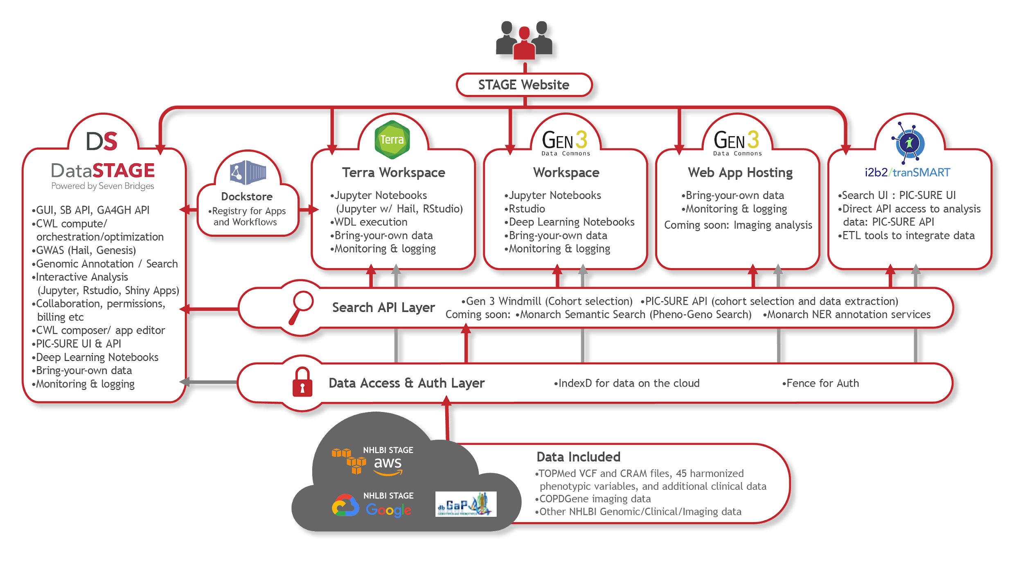
NHLBI BioData Catalyst
Architectural Diagram

Slide 10
Cancer Research Data Commons
Project Description
Participants
CRDC Vision: To enable all participants across the cancer research and care continuum, including providers and patients, to contribute, access, and analyze diverse data that will enable new discoveries and lower the burden of cancer.
CRDC Mission: To create a virtual, expandable infrastructure that provides secure access to multi-modal data, allowing users to analyze, share, and store results, leveraging the storage and elastic compute of the cloud.
CRDC Approach: To provide interoperable resources through federation, data harmonization, standards, and tools and services that can be reused across the research community and to enable enhanced data sharing.
Live since 2015, new nodes annually
Funder: NCI
PIs: Brandi Davis-Dusenbery, Anthony Philippakis, Bill Longabaugh, David Pot, Bob Grossman, Anand Basu, Ron Kikinis
Institutions:
Seven Bridges
The Broad Institute
Institute for Systems Biology
University of Chicago
General Dynamics Information Technology
Enterprise Science and Computing (ESAC)
Frederick National Labs
Brigham and Women’s Hospital

Slide 11
Cancer Research Data Commons
Data available
Tools available
Genomics: BEATML, CCL, CGCI, CPTAC, CTSP, FM, HCMI, MMRF, NCICCR, Organoid, TARGET, TCGA, VAREPOP, COSMIC, HCA, GECCO, LCCC 1108, PPTC
Proteomics: CPTAC2, CPTAC3, CPTAC-TCGA, PBTA
Imaging: TCIA
23+ datasets covering genomics, proteomics, imaging, and more. Some data are present in both AWS and GCP, some present only on one cloud infrastructure.
~300 Reference and analyzed datasets available in BigQuery
Bring your own data is available.
New data being added through both existing and new data nodes on a continual basis.
Full list at bit.ly/CRDCdatasets
Wide range of tools available across CRDC for all stages of analysis, types of users, with more added continuously by both new nodes and resources.
Bring your own tools is available.
SB: 427 publicly available tools and workflows in Common Workflow Language, + Dockstore, Rstudio, Jupyter notebooks, collaborative genome browser
Broad: >700 publically available workflows and tools in Workflow Development Language, Integrated Genome Viewer, Docktore, Jupyter notebooks, BigQuery, ML, pipelines
ISB-CGC: Google: VMs, BigQuery, AI, ML, Pipelines, Cohorts, Image Viewers, Notebooks, Plotting, Dockstore
GDC: Data Analysis Visualization Exploration (DAVE) tools allow users to interact intuitively with GDC data and promote the development of a true cancer genomics knowledge base.
PDC: Pepquery, Morpheus, Genome Browser, DDA & DIA common data analysis pipeline (coming soon)

Slide 12
Cancer Research Data Commons
Authentication
Authorization
eRA Commons IDs (controlled data)
NCI Data Commons Framework Services (DCFS) by Gen3
Individual, OIDC platform authentication
dbGaP access
DCFS by Gen3
Authorization enabled by Trusted Partnerships with NIH
Indexing
Data Models & More
Permanent globally unique IDs (GUIDs) for data in Google & Amazon locations
GUIDs are cloud agnostic, promoting access and providing a mechanism for versioning data
There are many data models across the CRDC, including ICDC, CTN, PDC, and GDC
Bridging efforts are underway
We also participate in GA4GH efforts

Slide 13
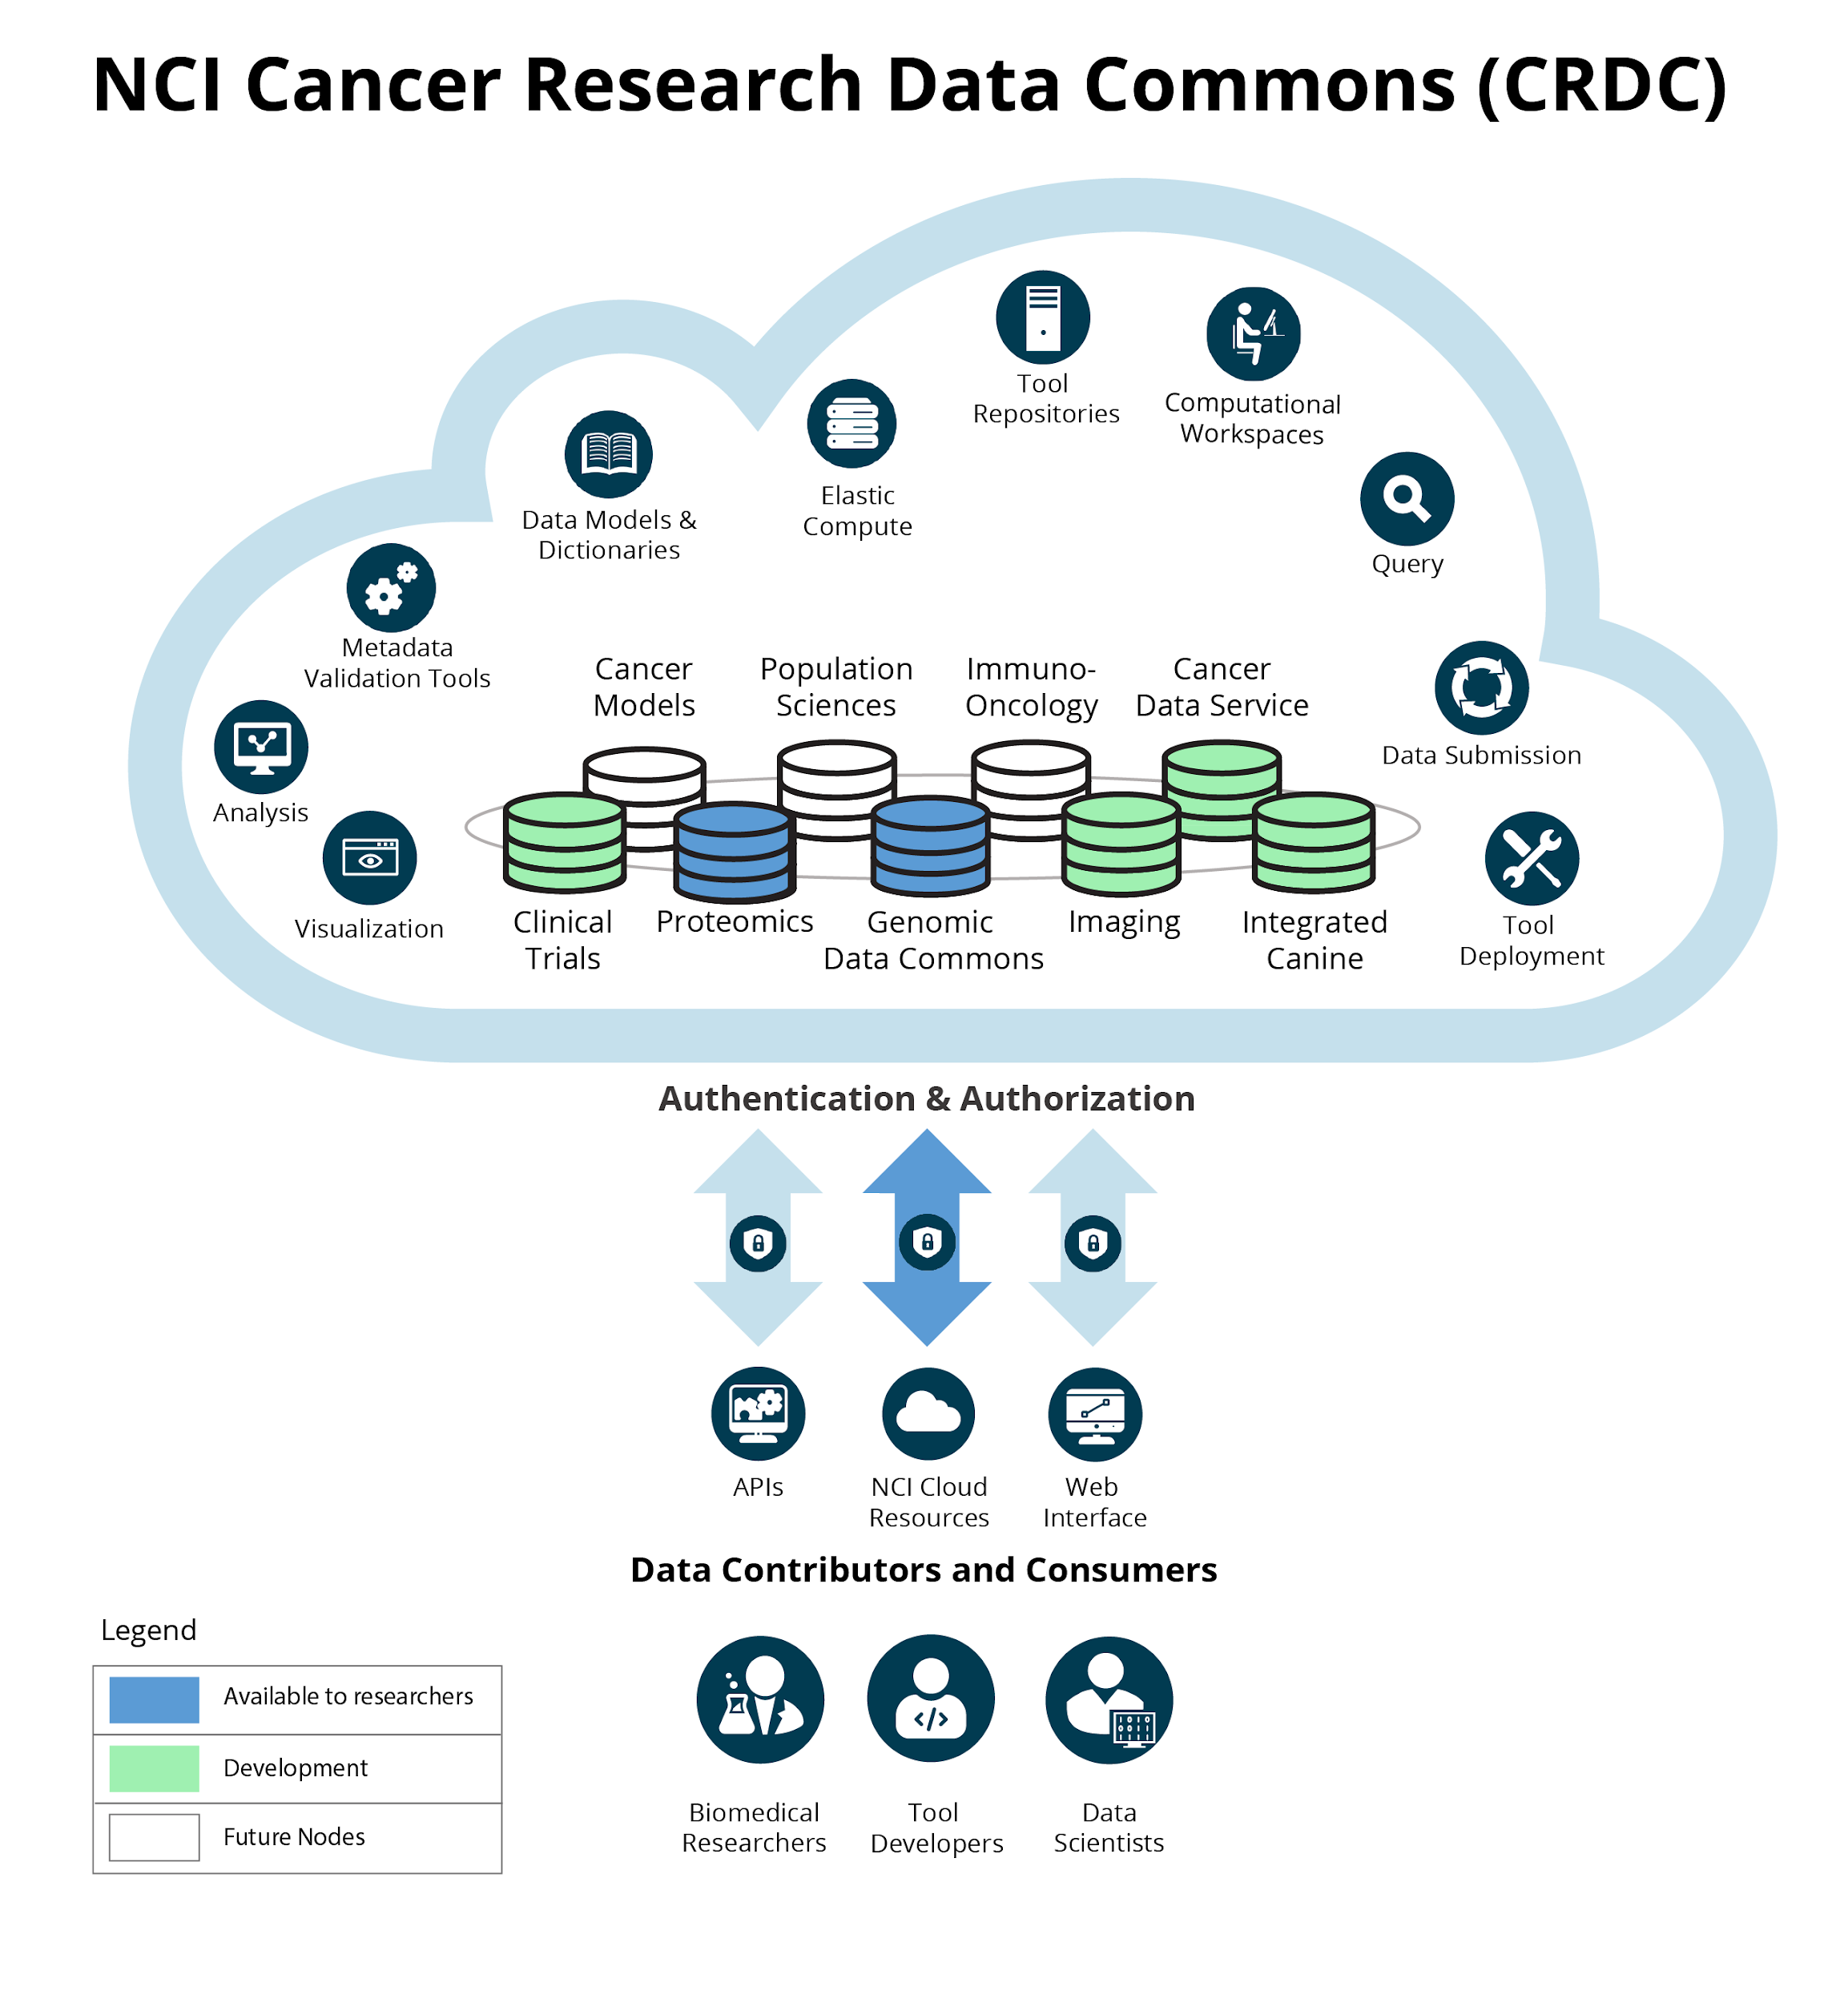
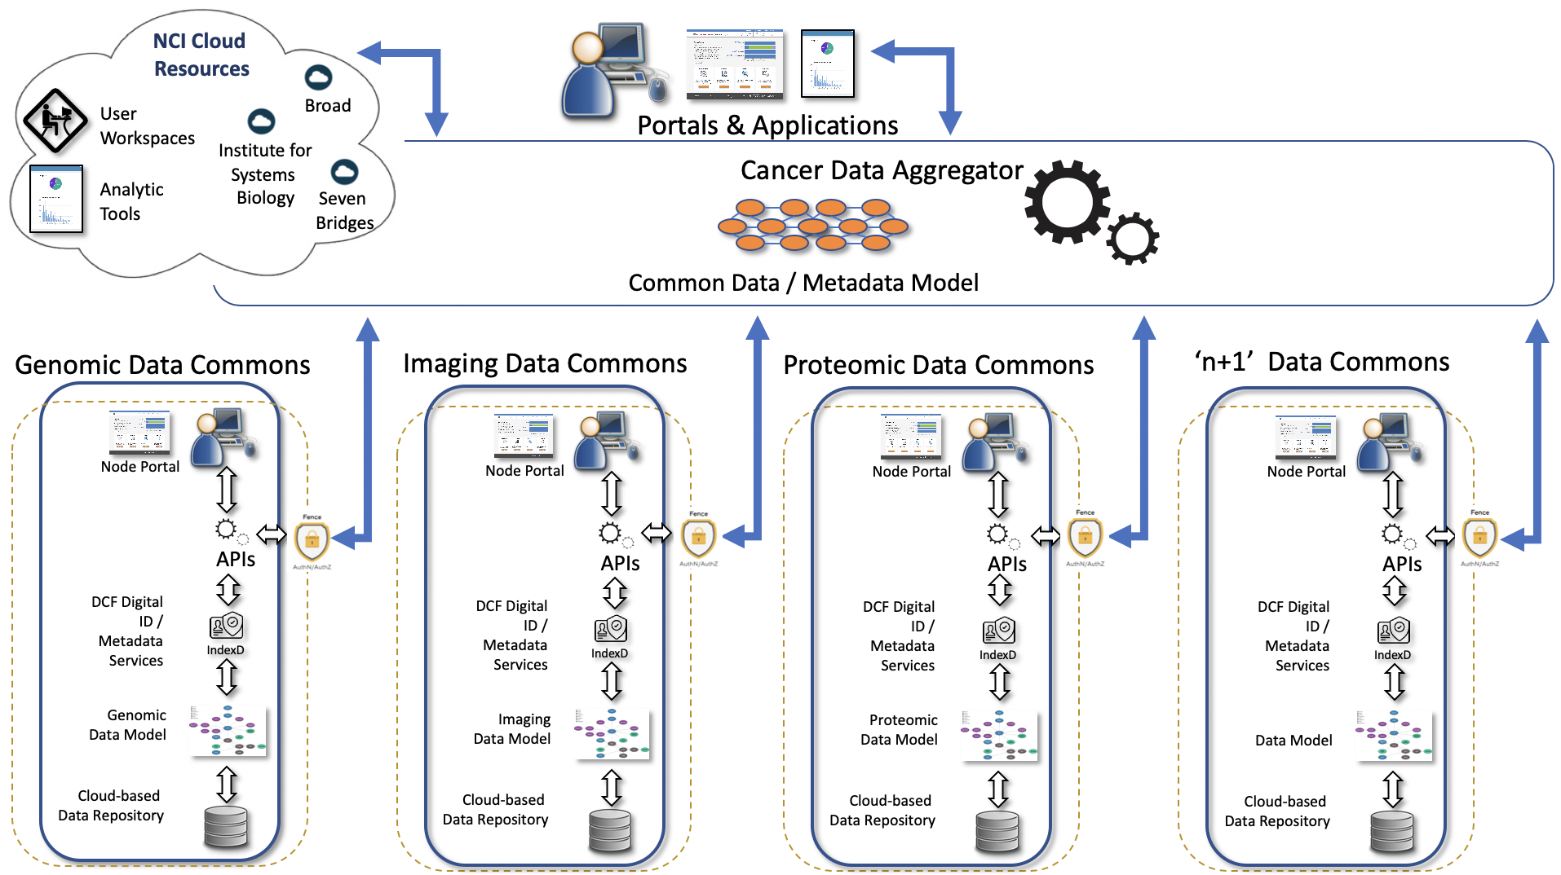
Cancer Research Data Commons
Architectural Diagram
User Perspective
System perspective

Slide 14
NHGRI AnVIL
Project Description
Participants
The NHGRI AnVIL is a cloud based environment that hosts high value data sets and commonly used bioinformatics tools in a secure environment that can scale to meet the computational needs of researchers.
The AnVIL will provide automated data access with the DUOS platform. AnVIL users will have access to extensive training materials spanning from general genomics to advanced analysis methods using modular and open access Massively Open Online Courses (MOOCs).
Go Live: July 2019
Go Live Date: July 1st, 2019
Funder: National Human Genome Research Institute, Eric Green (director), Valentina Di Francesco (program officer), Ken Wiley (program officer)
PIs: Philippakis, Taylor, Grossman, Morgan, Paten, Nekrutenko, Carroll, Goecks, Hall, Carey, Afgan, Leek, Hansen, Schatz, Ellrott, Waldron, MacArthur
Institutions: The Broad Institute, Johns Hopkins University, University of Chicago, Penn State University, University of California, Santa Cruz, Oregon HEalth and Sciences University, Harvard Medical School, Vanderbilt University Medical Center, Roswell Park Comprehensive Cancer Center, Washington University, City University of New York

Slide 15
NHGRI AnVIL
Data available
Tools available
AnVIL hosts CCDG, CMG, GTEx, and 1000 Genomes. As data sets are added to these groups they will become available on AnVIL. EMERGE will become available on AnVIL mid 2020.
AnVIL uses the Terra platform to launch and run tools on Google Cloud Platform within a FISMA secure boundary.
Users can currently run batch analysis with WDL and interactive analysis with Jupyter Notebooks supporting Python and R. The Dockstore workflow repository is integrated with Terra, providing access to hundreds of published workflows.
Access to Bioconductor through Jupyter Notebooks and R Studio is available and Galaxy will be available late summer 2020.
AnVIL will enable users to bring their own tools to the platform.
Source | Subject | Sample | Project
CCDG | 54302 | 54302 | 51
CMG | 6224 | 6228 | 28
1000 Genomes | 2504 | 2504 | 1
GTEx (v8) | 979 | 17382 | 1
eMERGE*

Slide 16
NHGRI AnVIL
Authentication
Authorization
Both Google emails and eRA Commons IDs are used as an authentication mechanism for controlled access data
Consortium and developer whitelists are maintained to provide access to data
General users submit DARs through dbGAP
Indexing
Data Models
Data objects are assigned permanent globally unique IDs (GUIDs)to allow for access across tools, without requiring copies be created and transferred
Datasets are identified through faceted search over phenotypic data
Functionality to support multiple, diverse data models is underway
These models are, where possible, being linked to external ontologies to improve consistency while maintaining diversity of datasets

Slide 17
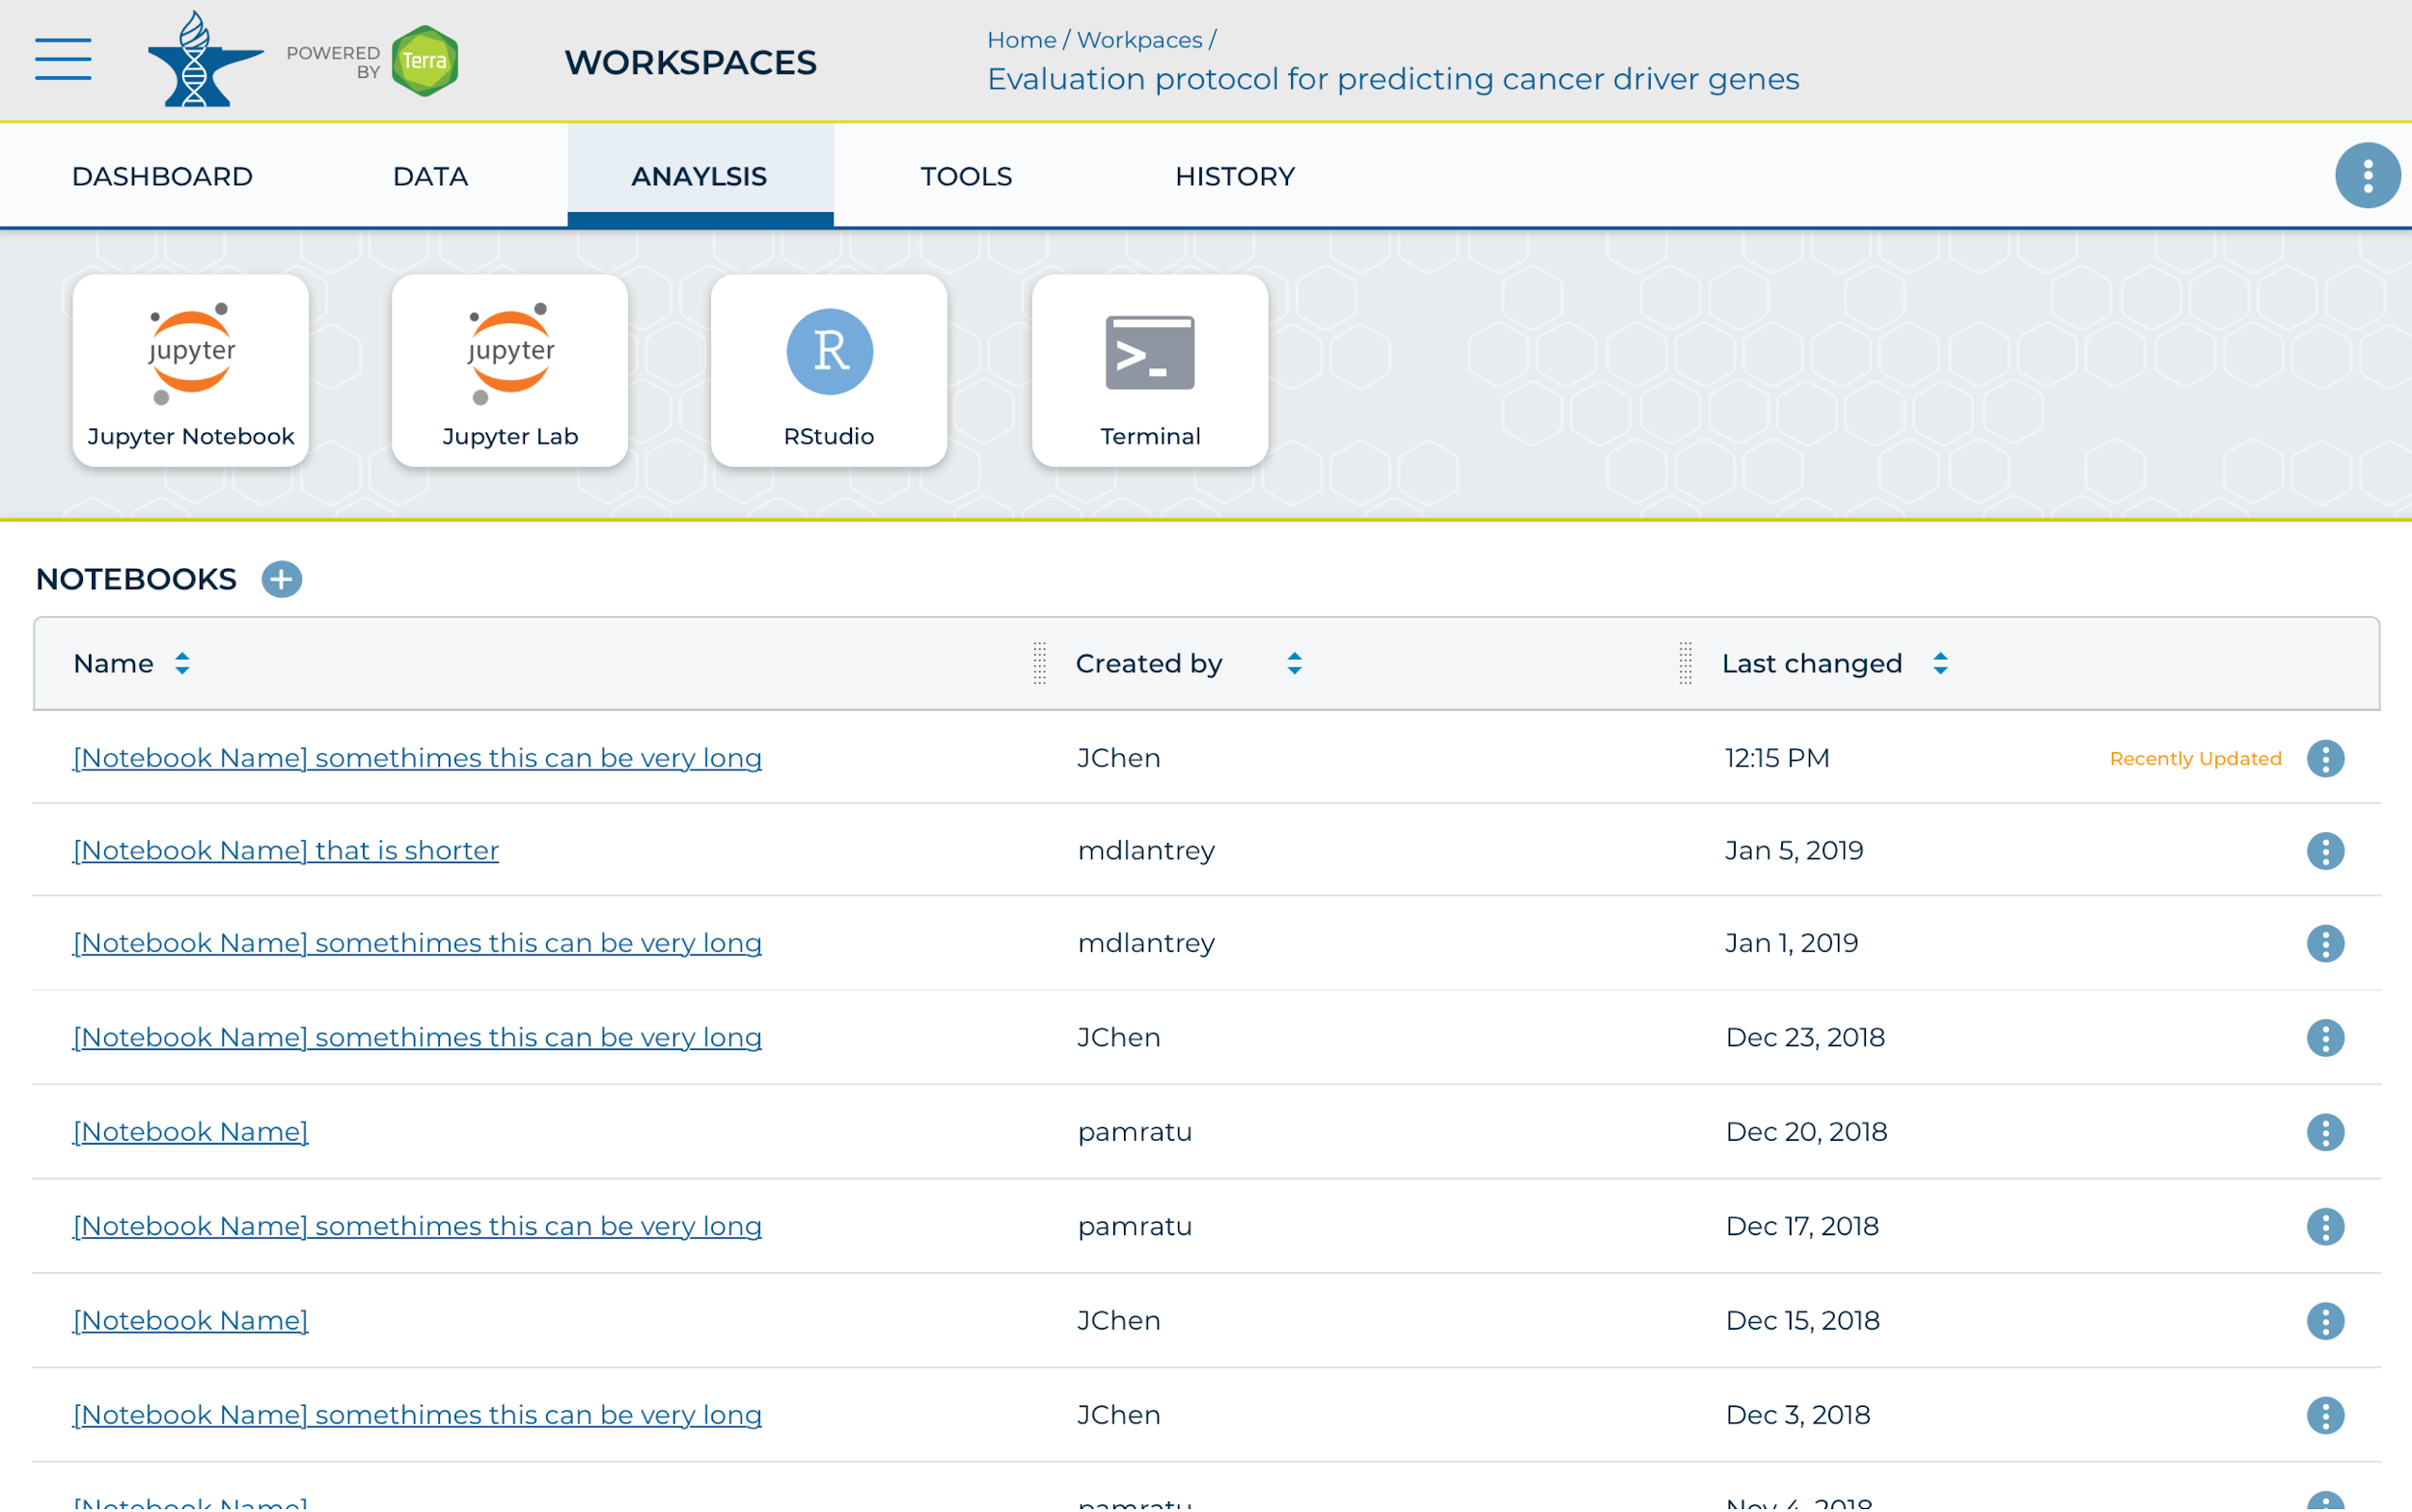
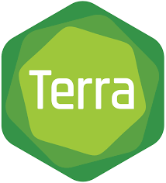
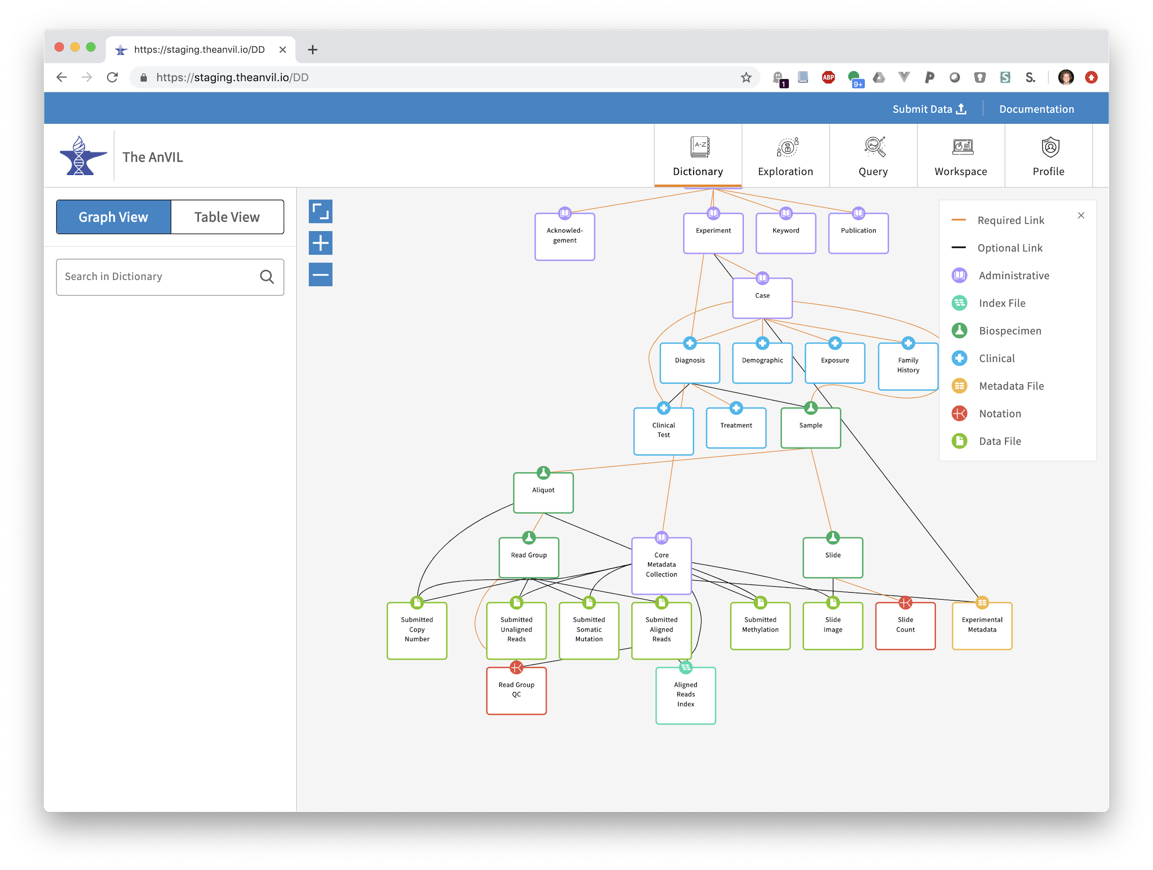
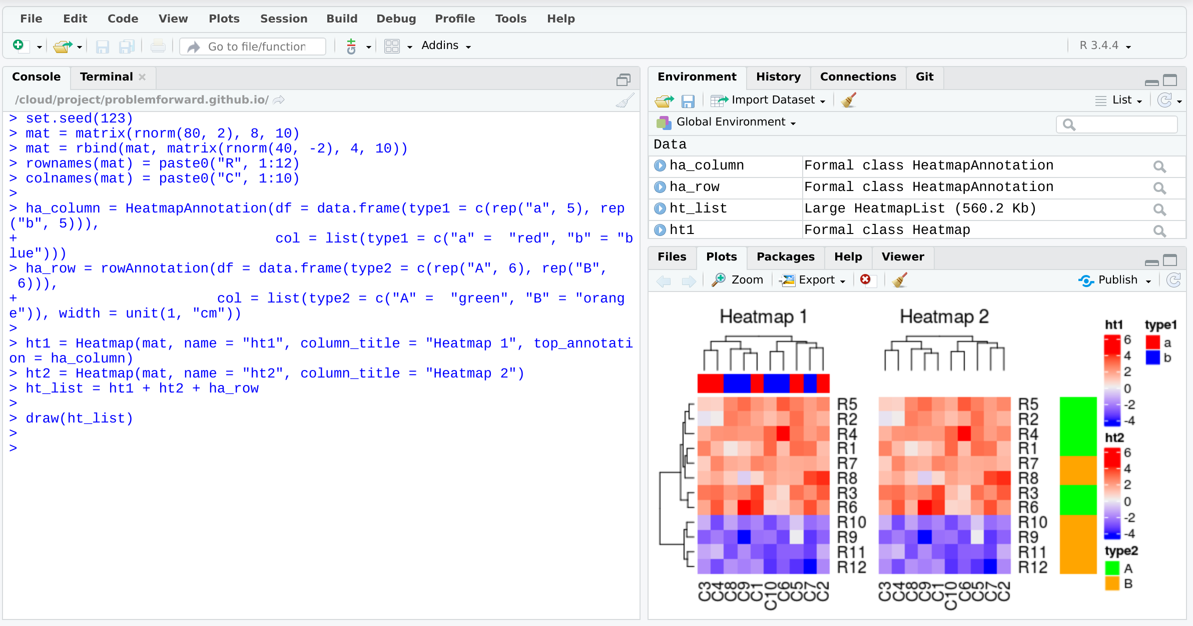
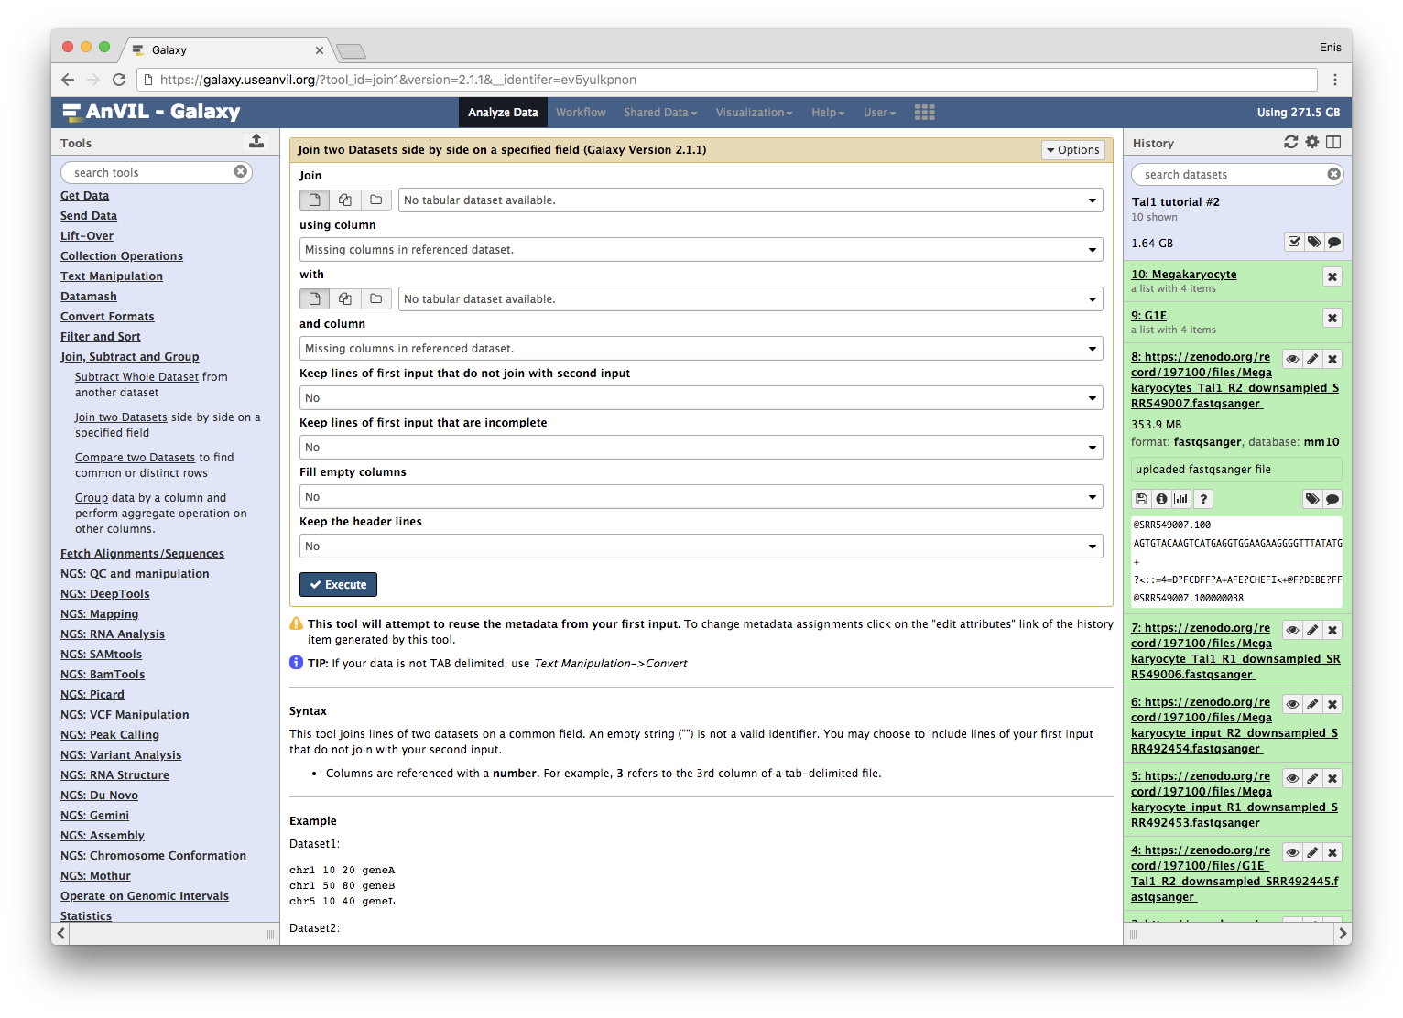
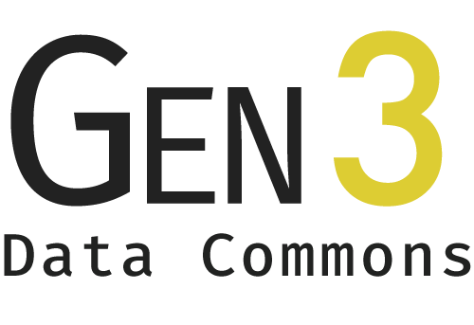
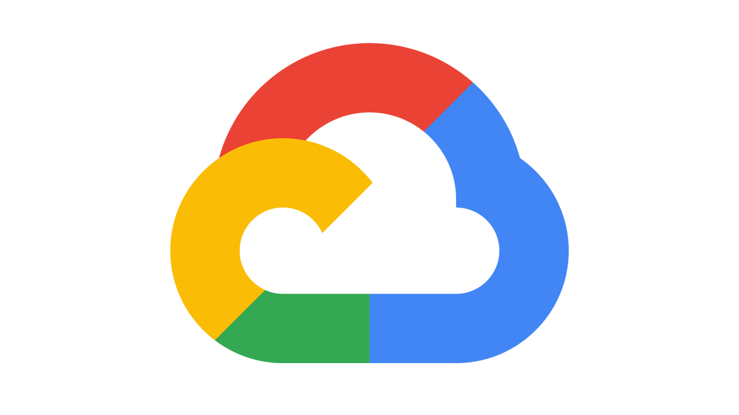
NHGRI AnVIL
Architectural Diagram
All data use and analysis in a FISMA moderate environment
AnVIL / Dockstore: sharing containerized tools and workflows
AnVIL / Terra: analysis workspaces and batch workflows
FISMA Moderate 2 ATOs Pursuing FedRAMP
AnVIL / Gen3: Data models, indexing, querying
AnVIL / Analysis Environments: Jupyter Notebooks, RStudio, Galaxy, ...
Implemented on

