Slide 1
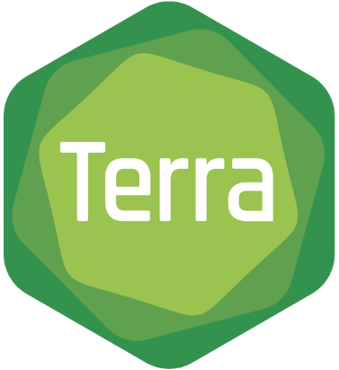
Terra Architecture and Design Overview
March 2020
Alex Baumann - abaumann@broadinstitute.org

Slide 2
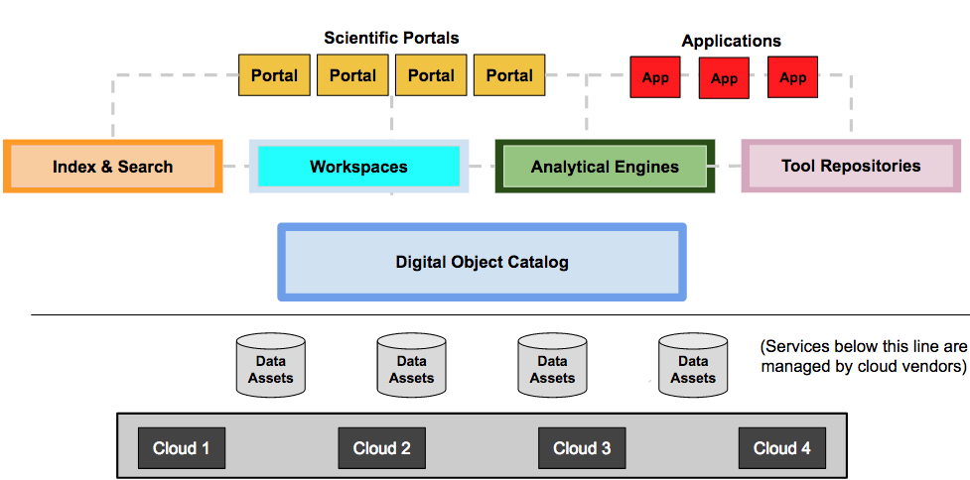
Driven by Data Biosphere vision to enable an ecosystem of interoperable components across orgs
DataBiosphere.org

Slide 3
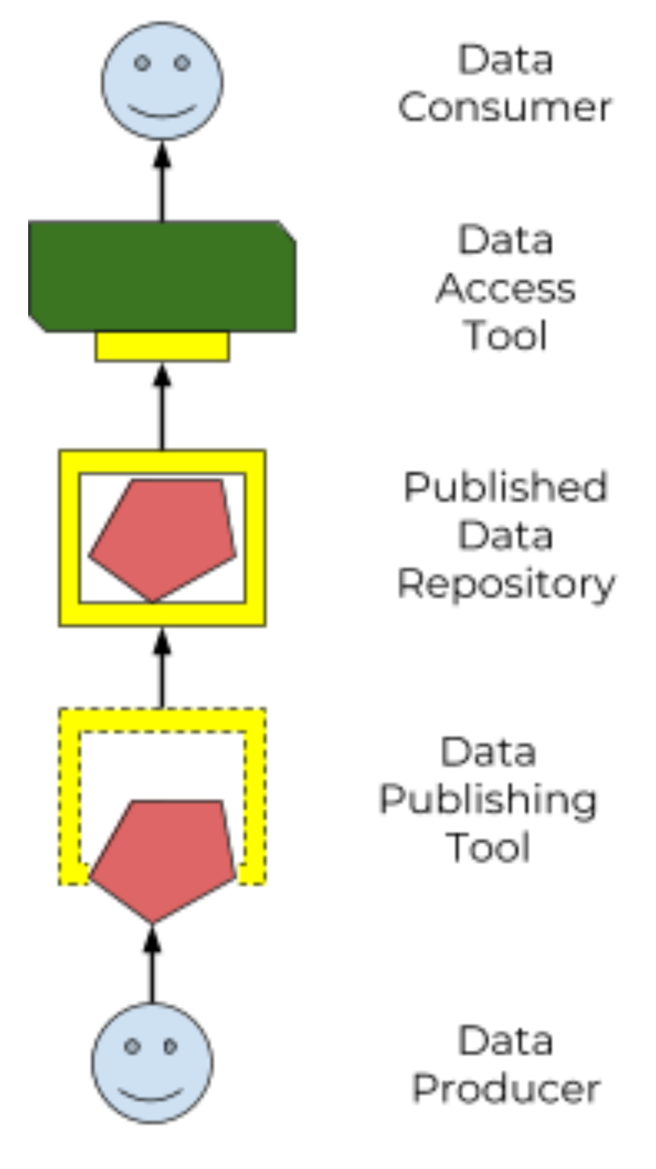
GA4GH standards used wherever possible
Tool Repository Service (TRS)
enable libraries of pre-packaged shared methods
Workflow Execution Service (WES)
federated analysis: run reproducible workflows
Data Repository Service (DRS)
federated storage: access data, wherever it’s stored
Data Use (DURI)
data passport: match access rules to researchers
Researcher Identity (DURI)
data passport: make researcher credentials portable
and more ...

Slide 4
Terra’s architecture primarily serves 3 roles
Biomedical
Researchers
All of Us
Workbench
Community
Workbench
Single
Cell Portal
Custom Apps & Portals
Data Generators
Tool Developers
Terra Platform API
Data Production & Curation
Data
Mgmt
Workspaces
Tools
Mgmt
Tool Creation & Publication
Cloud Services

Slide 5
Rearchitecture in progress to support multiple clouds and integration of new resources
Applications
Community Workbench
AoU Workbench
Single Cell Portal
Data Repo UI
Terra CLI
Third-party
Apps
App Services
Interactive Analysis
Terra Connector
Data Library
Cromwell
RStudio
Bioconductor
Tools, e.g.
Billing Reports
Jupyter
IGV
Hail
Terra Platform
Core Services
Workspace Manager
Data Repo Manager
Analysis
Code Repo
User
Manager
Spend Profile Manager
Folder Manager
Kernel
Access
Kernel
Policy Manager
Resource Manager
Notification Manager
IAM
Spend
Tracker
Activity Logger
Cloud
Layer

Slide 6
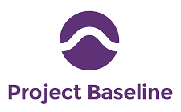
Many datasets co-analyzable according to research use
NHGRI AnVIL

Slide 7
Design principles and considerations
Not involved in billing now - user brings billing, we manage resources
Scale is critical (per month: ~2k active users, ~500 users running workflows and notebooks, ~500k workflows per month, >10m CPU hours per month)
Provenance is critical to reproducible data science
Authorization Domains to protect derived results

Slide 8
Questions?

